Slide 1
Welcome to our GCSE information evening

Slide 2
Aims of the evening
To share the changes to the GCSE curriculum and how this is now reported
Reporting home
Revision – new strategies (focussing on memory)
How you can help at home
Purchasing guides
Any questions?

Slide 3
GCSEs have changed…
Greater content and more knowledge based – recall of facts
Fully linear course with no modules – terminal examinations only and more of them
Reduced tiering – only Higher and Foundation for a few subjects
No controlled assessed element in English
More detailed, extended answer questions in the examinations
Marks allocated for Spag (spelling and grammar)

Slide 4
Attainment 8 and Progress 8 qualifying subjects

Slide 5
Attainment 8 and Progress 8 – how it is reported as a whole school
Level 5 is the ‘new’ grade C

Slide 6
Reporting
CAL Students are issued a current attainment level (CAL) for each subject at three points during the year. This level is based on their work in class to date as well as any assessments which have been carried out. It is reported as a points score
GCSE Target This is the target points score students are working towards at the end of year 11.
Progress
A = rate of progress estimated to be above target
O = rate of progress is on track to meet their target
C = rate of progress is a concern and the student is in danger of not meeting their target grade.

Slide 7
Reporting
NFS Points Scores | New GCSE Levels
0.0 -0.4 | 0
0.5 – 1.9 | 1
2.0 -2.9 | 2
3.0 – 3.9 | 3
4.0 – 4.9 | 4
5.0 -5.9 | 5
6.0 -6.9 | 6
7.0 -7.9 | 7
8.0 – 8.9 | 8
9.0 | 9
Points Score Conversion Table The conversion table shows the equivalent points scores and GCSE point score.

Slide 8
Career support for Year 9 – Employability skills
1. Self-motivation – taking responsibility for developing work readiness
2. Self-assurance – having the tools and skills to present themselves to employers
3. Aspiration – having high personal goals
4. Informed – understanding the opportunities available and making realistic choices
5. Experience – having experience of work that is rewarding and fulfilling
6. Achieving – qualifications valued by employers
7. Accountability – understanding how to take responsibility
8. Resilience – understanding employers need for people who can listen and learn
9. Entrepreneurial – working creatively to achieve personal and business potential
10. Co-operation – developing effective communication and co working skills
Unit of work in PSHCE
Workshops with Nottingham Trent University
Activity days in the summer term

Slide 9
November assessments
The assessments begin on Monday 20th November and end on Friday 1st December.
All subjects will be assessed in some form, whether this be a formal exam in the hall or as an assessed piece of work within the classroom.
All students have been given an exam timetable.

Slide 10
November assessments

Slide 11
Things to remember
A clear pencil with all equipment:
Pen, pencil, ruler, rubber, protractor, compasses, highlighters
A scientific calculator
Water bottle
Healthy snacks

Slide 12
Helping your child
Display the timetable at home
Take an interest in revision – help to test them!
Provide a quiet space and time
Food, drink, rest and sleep

Slide 13
English
Key information
How you can support your child
Course title and code: AQA English Language
Assessment:
Paper 1: Explorations in Creative Reading and Writing
50% of GCSE
Paper 2: Writers' Viewpoints and Perspectives
50% of GCSE
Outline: The GCSE course is a seamless transition from the Key Stage 3 course already studied; it will further develop and deepen the skills and understanding already built up over the last two years.
Each of the units are based around one literature fiction text and descriptive or narrative writing.
Encouraging them to read at home. This should be from a variety of texts, for example, newspapers, fiction, factual books.
All the information on each novel can be found in:
www.sparknotes.com. Type in the name of the novel and look at each point in the menu for notes on: context, summary, characters and analysis of each chapter.
You can also complete quizzes and do practice study questions.
Use BBC Bitesize www.bbc.co.uk/education
And choose GCSE – English Literature – 19th century prose – A Christmas Carol or Jekyll and Hyde.
You can read revision notes, watch a short video clip and take a quiz on: the plot summary, characters, themes, structure and language.
There are also sample exam questions to practise.

Slide 14
Mathematics
Key information
How you can support your child
Course title and code: AQA Mathematics 8300
Assessment: 100% examination; consisting of 3 exams each 1 hour 30 minutes long. The first paper is non calculator followed by 2 separate calculator papers.
Students will either sit a foundation paper covering grades 1-5 or a higher paper covering grades 4-9.
Outline: The GCSE course is a seamless transition from the Key Stage 3 course already studied; it will further develop and deepen the skills and understanding already built up over the last two years.
Each of the units are based around topics from the core areas of number, algebra, proportional reasoning, geometry, probability and statistics.
There are a lot of facts to memorise within mathematics; from rules for finding areas to information about perpendicular gradients for example.
Once these facts are learnt then it is key students practice applying them.
Questions can be straight forward where it is explicit as to the fact and method they should use.
Find the area of a rectangle with length 3cm and width 8cm.
Or a question can being wordier and more problem solving where the mathematics required maybe hidden among lots of other information.
Sarah is going to returf her lawn. She can buy turf in strips of 30cm by 100cm. Her garden is 3m by 8m. How many strips of turf will Sarah need to buy?
Help your child to memorise the facts, learn how to break questions down and then practice, practice, practice applying their knowledge to different types of questions.

Slide 15
Science
Key information
How you can support your child
We offer two science course at Nottingham Free School: Triple and Trilogy science.
Triple is split up into three subjects: Biology, Chemistry and Physics and the pupils will be awarded a grade for each. This is the route followed by the a band. Pupils have 9 lessons per week.
Trilogy is also split into Biology, Physics and Chemistry but pupils will be awarded two science grades rather than 3. This is the route followed by the B band. Pupils have 6 lessons per week.
For all routes pupils will be able to achieve grades 1-9.
In Physics pupils are expected to learn 23 equations and be able to use a further 12 given in an information sheet.
Over the next three years we will cover a lot of content and there are many facts that your child needs to know. To help you can:
Ensure pupils regularly review the work covered in lessons.
Support your child to make a bank of flash cards of the information they need to know and test them regularly.
Purchase revision guides from the school and encourage them to read over information covered in lessons and answer the questions.
Practice exam style questions when revising and help your child to mark these following the mark scheme.
Ask your child if they have understood what they have covered in class by getting them to explain concepts to you. If they can’t then encourage them to see the teacher before too much time has passed.

Slide 16
Are you ready for a challenge?

Slide 17
One minute to Memorise ALL of these FACTs:
A crocodile can't stick it's tongue out.
A shrimp's heart is in it's head.
It is physically impossible for pigs to look up into the sky.
A pregnant goldfish is called a twit
Rats multiply so quickly that in 18 months, two rats could have over a million descendants.
Wearing headphones for just an hour will increase the bacteria in your ear by 700 times.
Thirty-five percent of the people who use personal ads for dating are already married.
A duck's quack doesn't echo, and no one knows why.
23% of all photocopier faults worldwide are caused by people sitting on them and photocopying their behinds.

Slide 18
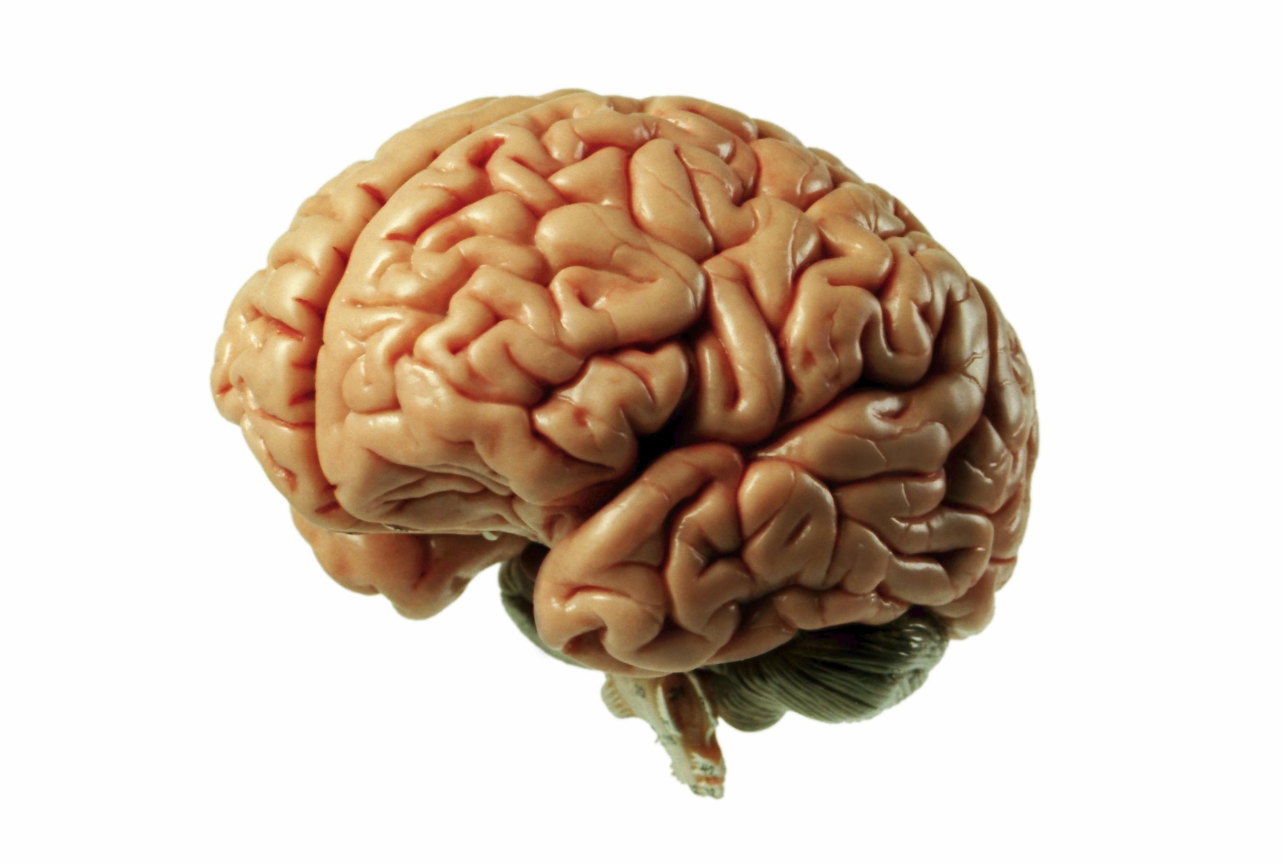
So how does our memory work?

Slide 19
How Does Memory Work?
Information
Decay
Recall
Encoded
Sensory Register
Short Term Memory
Medium Term Memory
Long Term Memory
Filtered: some information goes to STM.
30 seconds: lost to decay / interference or refreshed and reinforced through attention and repetition.
1 week
Indefinite

Slide 20
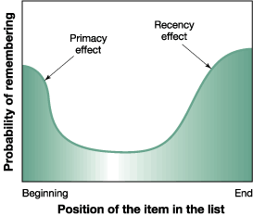
How Does Memory Work?
Your short term memory can only really handle 7 pieces of information at a time.
STM suffers from primary effects (you can remember the first things you heard)
STM also suffers from recency effects (you can remember the last things you heard)

Slide 21
Chunking means organising information into manageable chunks – remembering the 7 item capacity of STM.
Chunking
If you can organise pieces of information into manageable chunks it may help them to remember more.
Let’s try it. Remember these 13 letters.

Slide 22
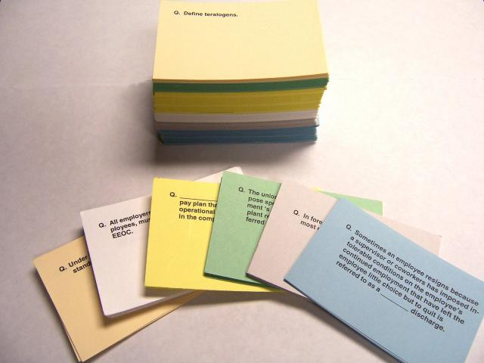
Flashcards

Slide 23
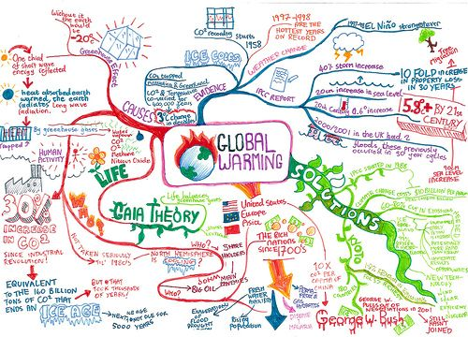
Mind maps

Slide 24
Look, say, cover, write, check

Slide 25
The memory palace

Slide 26
Drink more!!!!
Over 70 percent of your body is composed of water and every function in the body is dependent on water, including the activities of the brain and nervous system.

Slide 27
Eat often!!!!
Like an expensive car, your brain functions best when it gets only premium fuel. Eating high-quality foods that contain lots of vitamins, minerals, and antioxidants nourishes the brain and protects it from oxidative stress — the “waste” (free radicals) produced when the body uses oxygen, which can damage cells.

Slide 28
Sleep more!!!!
Although scientists continue to debate the purposes and benefits of sleep, one thing is clear: sleep deprivation is really bad for brain function.

Slide 29
All homework set from this point forward will be linked in someway to revision.
During your independent study sessions, you should be using your revision guide to inform you of what you need to cover for each subject.

Slide 30
These revision guides have been designed to support students with help to plan their revision time appropriately.

Slide 31
‘I can….’ statements
Each subject has provided a list of ‘I can…’ statements. Your aim, by the end of the revision period, is to be able to do all of the ‘I can…’statements. This will mean that you are fully prepared for your exam.
Each time you cover an ‘I can….’ statement, you need to put a tick in the box next to it. You should aim to cover each statement 3 times in your revision.

Slide 32
Key terms and definitions
Each subject has provided a list of key terms which are vital to you achieving good grades in each exam.
You need to write down the definition for each of the key terms in the table. You can then revise this list.

Slide 33
Each subject has a memorisation box. This shows the key information that you will need to memorise in order to be successful in the exam
There is also a box to show the best revision techniques for each subject. Try to use these techniques where possible.

Slide 34
Each subject has a memorisation box. This shows the key information that they will need to memorise in order to be successful in the exam
There is also a box to show the best revision techniques for each subject. Try to use these techniques where possible.

Slide 35
Purchasing revision guides
We have given you a list of the revision guides which are available to purchase.
The revision guides will be useful for the full 3 years of the GCSE course.
The final order date for revision guides will be Friday 1st December.

Slide 36
Any questions?

