Slide 1
Questions to discuss……
What do your children do online?
Are your child’s online friends the same as real life friends?
Do you know how to check on who your child is talking to?
Have you checked your child’s online privacy recently?
Have you discussed ‘stranger danger’?
Do you know how remove cyberbullying comments?

Slide 2
Welcome to the parents’ forum

Slide 3
Facts
Social media
Cyber-bullying
Keeping your child safe
School policy

Slide 4
Internet facts
The internet is a fantastic tool and an ever increasing part of our daily lives.
Children are likely to experience/participate in:
Using search engines
Sharing images and watch videos
Using forums and social networking sites
Playing games (alone or with others)
Chatting to others online or through mobile apps

Slide 5
Internet facts
Children spend an average of 12 hours per week online
92% of teenagers go online daily and 24% say they go online ‘almost constantly’
Over 70% of teenagers own a smartphone
91% said their preferred method of going online was on a smartphone
A typical teen sends and receives 30 texts daily
Usage of social networking sites increases as children get older
Notes:
Usage of social networking sites increases as children get older
Overall, 76 percent of teens use social media sites and apps, although usage is higher (81 percent) among 15- to 17-year-olds than it is among younger teens.

Slide 6
Internet facts
New learning
Keep in touch with friends and family
Help with homework
Be creative
Inappropriate content including pornography
‘Friends’ and contact with people they don’t know
Inappropriate age-related content
Sharing personal information
Grooming and sexual abuse
Accruing debts and gambling

Slide 7
Social media
Chat rooms, social network sites, group chats, group games
Quiz time!
http://www.net-aware.org.uk/
Notes:
Name as many icons as possible – do as a group.
Extn – what are the top 5?
Facebook was the most popular social media platform among the teens polled with 71% of them indicating they used the service.
Second was Instagram at 52%, followed by Snapchat at 41%. Twitter and Google+ came in at 33%.
Eighty-nine percent say they use at least one of the following: Facebook, Twitter, Instagram, Snapchat, Tumblr, Google Plus or Vine.
Go through the answers and show the NSPCC website – look at one icon and show that it gives age restrictions etc.
Pick out some of the ones which are anonymous

Slide 8
Social media
Chat rooms, social network sites, group chats, group games
50% have seen sexual, violent and other adult material on social media sites, apps and games
78% of children reported that they had joined social media sites before reaching the specified minimum age
Top five 5 sites where young people reported seeing inappropriate content:
While young people rated Chatroulette, Omegle and Tumblr as high risk for sexual content, parents rated them as low risk
Sickipedia (100% of children surveyed)
Chatroulette (92%)
Omegle (89%)
Ask.fm (88%)
Yik Yak (74%).
http://www.net-aware.org.uk/
Notes:
Name as many icons as possible – do as a group.
Extn – what are the top 5?
Facebook was the most popular social media platform among the teens polled with 71% of them indicating they used the service.
Second was Instagram at 52%, followed by Snapchat at 41%. Twitter and Google+ came in at 33%.
Eighty-nine percent say they use at least one of the following: Facebook, Twitter, Instagram, Snapchat, Tumblr, Google Plus or Vine.
Go through the answers and show the NSPCC website – look at one icon and show that it gives age restrictions etc.
Pick out some of the ones which are anonymous

Slide 9
New apps/websites to be aware of…..
Blue Whale - originated in Russia. It encourages self harm for 50 days then committing suicide on the last day. Young people carve a whale on their forearm. In Hampshire, there have been 2 completed suicides and 2 very near misses.
Yellow – a new dating app for under 18’s.
Sayat.me - is very similar to ask.fm and is having some unpleasant outcomes. People can sign up with facebook, twitter or skype.

Slide 10
Sexting – also known as ‘trading nudes’, ‘dirties’ and
‘pic for pic’
The sharing of inappropriate or explicit images or written messages online or through mobile phones.
Sending pictures and inappropriate content has become normal teenage behaviour. It is seen as flirting by children and teenagers who feel that it is part of normal life.
Leaves people vulnerable to bullying and harm
No control over the sharing of images
The dangers
Can have long term harmful effects
It’s illegal
http://www.nspcc.org.uk/preventing-abuse/keeping-children-safe/sexting/
Notes:
No control
It's easy to send a photo or message but the sender has no control about how it's passed on.
When images are stored or shared online they become public. They can be deleted on social media or may only last a few seconds on apps like Snapchat, but images can still be saved or copied by others.
These images may never be completely removed and could be found in the future, for example when applying for jobs or university.
Harmful effects
Young people may see 'sexting' as harmless activity but there are risks. Taking, sharing or receiving an image, even voluntarily, can have a long-lasting negative impact. – discuss the emotional impact and possible impact on career etc
Illegal
It may be common but 'sexting' is illegal. By sending an explicit image, a young person is producing and distributing child abuse images and risks being prosecuted, even if the picture is taken and shared with their permission
Vulnerable to bullying etc:
Blackmail An offender may threaten to share the pictures with the child's family and friends unless the child sends money or more images.
Bullying If images are shared with their peers or in school, the child may bebullied.
Unwanted attention Images posted online can attract the attention of sex offenders, who know how to search for, collect and modify images.
Emotional distress Children can feel embarrassed and humiliated. If they are very distressed this could lead to suicide or self-harm.

Slide 11
Sexting – Four steps to trouble
1: Sarah, 14, takes a sexual photo of herself on her camera-phone and sends it to her boyfriend James, 15.
Sarah is now potentially guilty of distributing child pornography. James is potentially guilty of possession of child pornography
2: Sarah dumps James. Out of revenge James sends the photo to his friends at school.
James is now guilty of distributing - and his friends of possession - of child pornography. Sarah is embarrassed as a sexual photo of herself circulates school
3: James’s friend uploads the photo to a social networking profile, where his photos are visible to the public.
James is in breach of website terms and guilty of distributing child pornography
4: Paedophiles browse profiles with loose privacy settings and find the image of Sarah.
Sarah unwittingly becomes the subject of child pornography for distribution among strangers and paedophiles
Notes:
Go through and ask for feedback at each stage.
Give out the Daily Telegraph article for further reading

Slide 12
What the law says on sexting
A young person is breaking the law if they:
take an explicit photo or video of themselves or a friend
share an explicit image or video of a child, even if it’s shared between children of the same age
possess, download or store an explicit image or video of a child, even if the child gave their permission for it to be created.
However, as of January 2016 in England and Wales, if a young person is found creating or sharing images, the police can choose to record that a crime has been committed but that taking formal action isn't in the public interest.
Crimes recorded this way are unlikely to appear on future records or checks, unless the young person has been involved in other similar activities which may indicate that they're a risk.

Slide 13
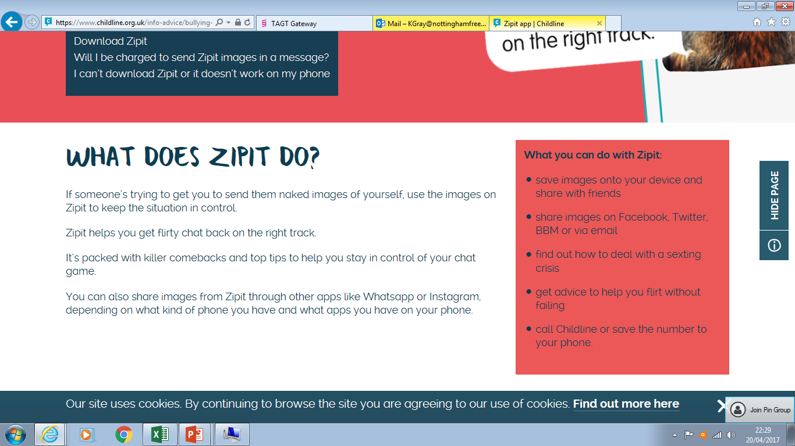
ZIPIT APP - https://www.childline.org.uk/info-advice/bullying-abuse-safety/online-mobile-safety/sexting/zipit-app/

Slide 14
Cyber-bullying
Bullying that happens online, via social networks and on mobile phones. It is usually repeated over a period of time and the victim can feel that there is no escape because it can happen wherever they are and at any time.
http://www.nspcc.org.uk/preventing-abuse/child-abuse-and-neglect/bullying-and-cyberbullying/
Notes:
Some signs that your child might be experiencing some form of bullying
Better to talk to us with any concerns as we can always keep an eye out

Slide 15
Cyber-bullying
Talk about cyberbullying (and bullying)
Know how not to react
Know who to go to for help
Teach them how to stay safe online
http://www.nspcc.org.uk/preventing-abuse/child-abuse-and-neglect/bullying-and-cyberbullying/
Notes:
Important that they are aware and know that you are aware too. They know that they can talk to you about it
Make sure they know not to respond to horrible texts or pictures – keep a screenshot of everything (even snapchat can take a screenshot when it’s on screen). They then have the evidence to show someone.
Parents, relatives, family friend, teachers, childline
Have an open dialogue at home about online safety – will cover top tips later on

Slide 16
Keeping your child safe – what do you do now?
Talk about it regularly
Go online together
Know who your child is ‘friends’ with online
Set rules and boundaries
Use parental controls
Check content is age-appropriate
Ensure your child understands privacy setting and how to report it
Notes:
Talk about it regularly
Children and young people spend an average of 12 hours a week online and it becomes part of their routine early on in life. That's why it's important to start talking to your child about keeping safe online at an early age.
It's easier to have conversations about online safety little and often, rather than trying to cover everything at once.
As your children get older, and technology changes, make sure you keep talking about what they're doing online and how to stay safe.
Go online together
Ask your child to show you their favourite things to do online, and show an interest in what they do - just like you would offline. This will give you a much better idea of what they're getting up to. And it gives you a way to support and encourage them while learning what they know. Often daunting when they know more about it than we do but it can easily become a very secret world especially as they become teenagers and don’t want to talk to their parents about everything (v natural process but can be dangerous when online)
Know who your child is ‘friends’ with online
Children don't think of people they've met online through social networking and online games as strangers, they're just online friends.
So it's important to keep track of who your child's talking to. Ask them questions like:
who do they know that has the most online friends?
how can they know so many people?
how do they choose who to become friends with online?
Explain to your child that it's easy for people to lie about themselves online, like their age, for example, because you have never met them.
Agree your child will 'friend' a trusted adult on their social networks or online games.
You could also become 'friends' with your child so you can see their profile and posts but your child may not want to 'friend' you, especially as they get older. Agree that your child can 'friend' a trusted adult like an aunt or uncle so they can let you know if they see anything worrying on your child's profile.
Set rules and boundaries
It's useful to agree on some ground rules together. These will depend on your child's age and what you feel is right for them, but you might want to consider:
the amount of time they can spend online
when they can go online
the websites they can visit or activities they can take part in
sharing images and videos
how to treat people online and not post anything they wouldn't say face-to-face.
If your child plays online games:
check the age rating before they play
make sure you know who they're playing with
talk to them about what information is OK to share with other players
negotiate the amount of time they spend playing online games. – Mention FIFA
Use parental controls
You can set up parental controls to stop your child from seeing unsuitable or harmful content online:
Internet Service Providers (ISPs), such as Virgin Media, TalkTalk, Sky or BT, provide controls to help you filter or restrict content.
Laptops, phones, tablets, game consoles and other devices that connect to the internet have settings to activate parental controls.
Software packages are available - some for free - that can help you filter, restrict or monitor what your child can see online.
Remember that if your child goes online away from home, the same controls might not be in place at other people's houses or on public Wi-Fi. Agree with your child how they will use public Wi-Fi or let other parents know what your child is or isn't allowed to do online.
As your child gets older you can change the level of control that you use. If your child asks you to remove the controls completely, and you are happy to do so, make sure you agree what behaviour is acceptable online first.
Check content is age-appropriate
You know your child best, so check that the websites, social networks and games they're using are suitable for them.
Check that your browser's homepage (the page that you see when you open an internet window) is set to a website that you're happy for your child to see.
Online games, movies and some websites will also have an age rating or minimum age to sign up. Age limits are there to keep children safe. So you shouldn't feel pressured into letting your child sign up or use websites that you feel they are too young for.
Ensure your child understands privacy setting and how to report
Check the privacy settings on any online accounts your child has, like Facebook or games, and remind them to keep their personal information private.
And talk to your child about what to do if they see content or are contacted by someone that worries or upsets them. Make sure they know how to use tools to report abuse.

Slide 17
Conversation starters…….
Ask your children to tell you about the sites they like to visit and what they enjoy doing online.
Ask them about how they stay safe online. What tips do they have for you, and where did they learn them? What is OK and not OK to share?
Ask them if they know where to go for help, where to find the safety advice, privacy settings and how to report or block on the services they use.
Encourage them to help. Perhaps they can show you how to do something better online or they might have a friend who would benefit from their help and support.
Think about how you use the internet as a family. What could you do to get more out of the internet together and further enjoy your lives online?

Slide 18
Family agreements…….
A family agreement is a great way to start a conversation with your whole family about how you all use the internet, and discuss together how to behave in a positive way when online at home, at school, at friend’s houses etc. Bear in mind it is difficult to have complete control over your family’s internet usage, however a family agreement is a great way to set clear expectations for positive and safe internet use.

Slide 19
Keeping your child safe
The NSPCC website is an excellent resource for parents:
General tips for keeping safe online
http://www.nspcc.org.uk/preventing-abuse/keeping-children-safe/online-safety/
https://www.ceop.police.uk/
http://www.saferinternet.org.uk/safer-internet-day/2016/education-packs/parents
Research how different social network sites/games/apps work
http://www.net-aware.org.uk/
Sexting
http://www.nspcc.org.uk/preventing-abuse/keeping-children-safe/sexting/
There are alternatives!

Slide 20
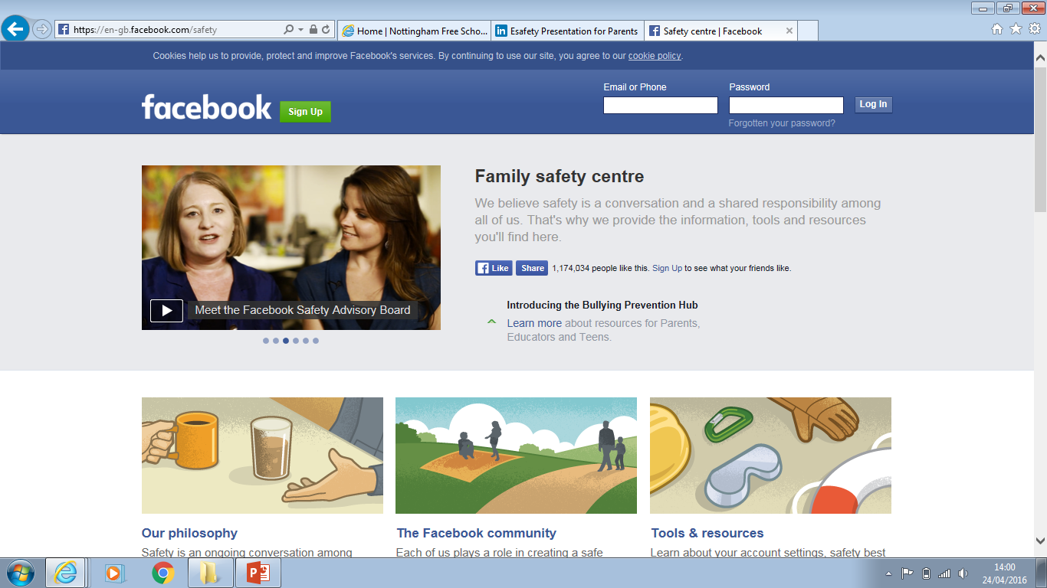

Slide 21
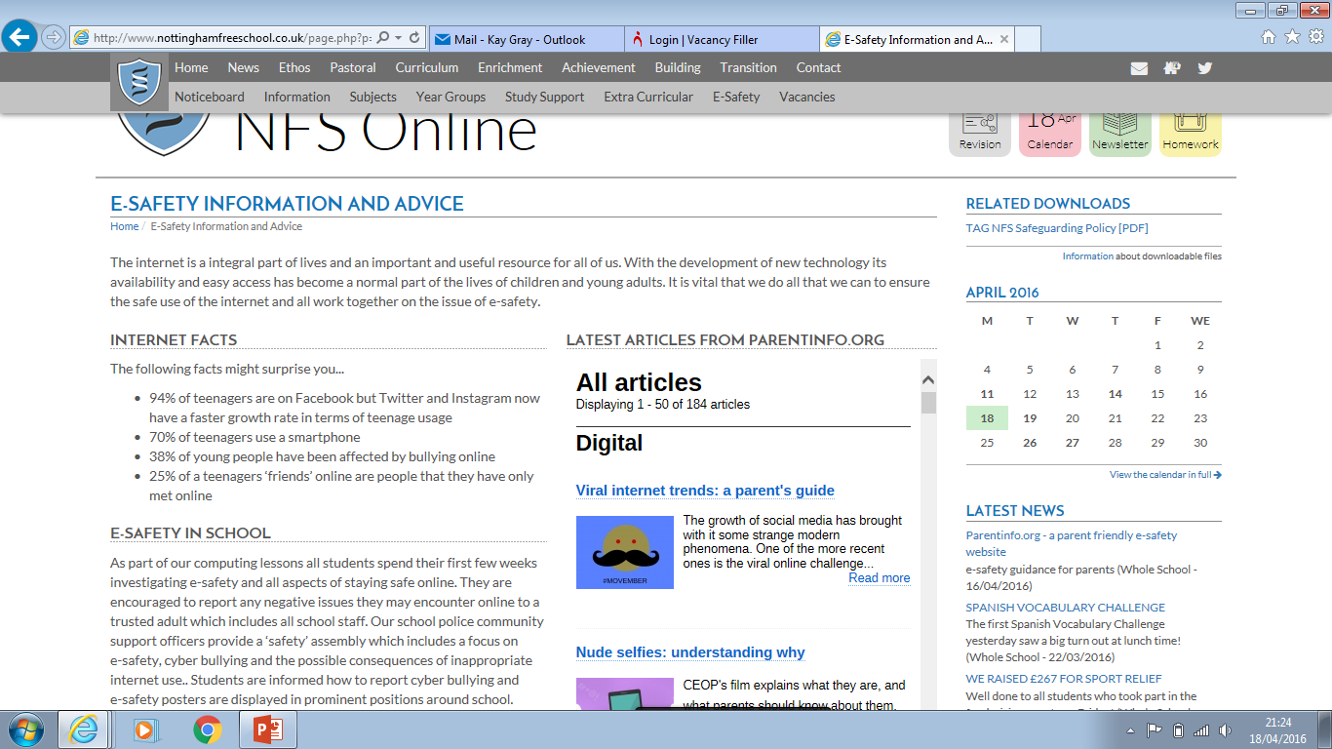

Slide 22
School policy
The Rules!
Mobile phones seen or used (even if used to contact a parent) during the day are confiscated and have to be collected by a parent/carer
iPads are used as a learning resource and are confiscated for periods of time if used inappropriately
Incidents involving internet misuse/cyber-bullying are dealt with in school (even if they occur out of school time) according to our behaviour policy and the police may be involved. Evidence is vital!
Notes:
Taking screenshots. Children should be told to do this if they ever receive anything negative and to take screen shots. They should not reply nor delete any evidence.
Most secondary schools are dealing with this on a daily basis – it is the biggest safeguarding issue that schools face and it takes a great deal of staff time.
School staff are not the police and so when issues happen out of school that are not school related we will deal with them but it is very likely that we will involve the PCSO’s/police.

Slide 23
School policy
Support
Many opportunities taken for raising the profile of e-safety (assemblies, units of work etc) in every year group
PHeW (Pupil Help and Welfare)
PCSO’s
Safer Internet day 6th February
Notes:
Reminder about PHEW – access it on the school website and report anything of concern. Can also be anonymous (but is then obviously harder to deal with)
This presentation is not meant to scare but meant to inform.
Important that parents have a level of awareness of the possible dangers and that there is a great deal of support for them. THE most important thing is to have regular conversations with their children and be part of their online world.

