Slide 1

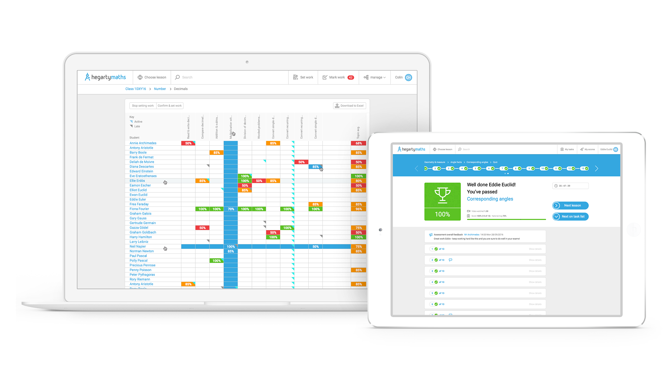
Empowering YOU to become an amazing independent learner in maths…

Slide 2
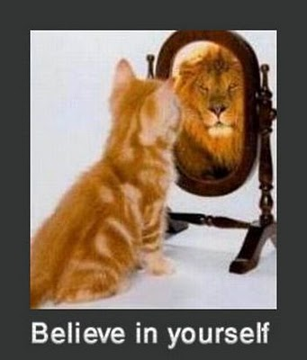
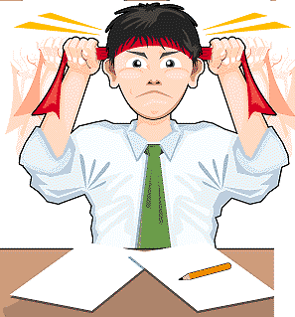
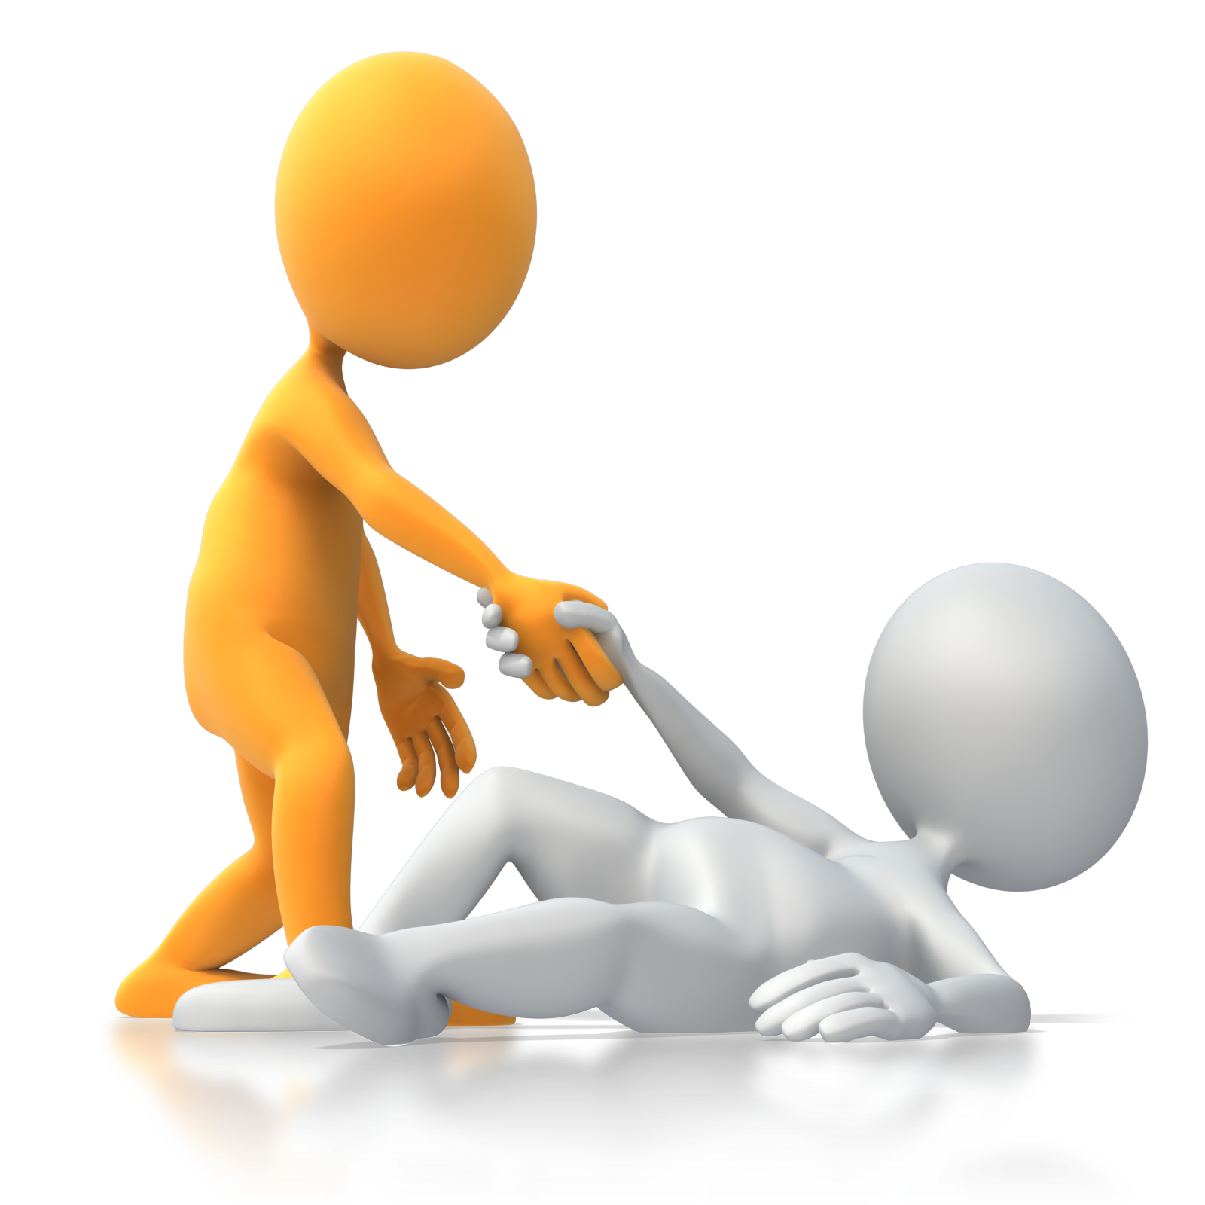

There are 3 things that will help you thrive in maths:
1) You have to have a positive mindset and belief:
You need to believe you can improve and can succeed in maths. You definitely can do better than you thought possible so start believing that today!
2) You have to work incredibly hard:
When you work hard and follow your teacher’s guidance you will improve quickly. You have to always concentrate and listen carefully, write your maths down with care, copy down modelled examples from your teacher and concentrate hard when practising questions.
3) You need support:
You need the best support / teaching. In class that is a teacher who explains the maths well, models for you good examples and inspires you.
+
Hard
work
Support
Success in maths
Belief
+
=

Slide 3
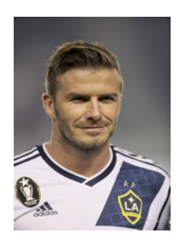
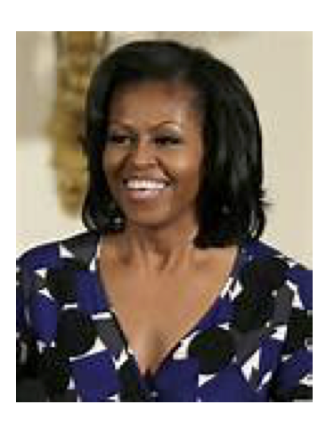
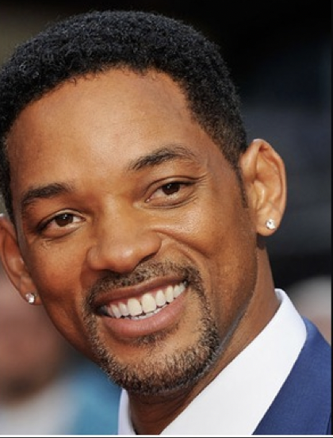
All successful people know the value of hard work…
“My secret is practice. I have always believed that if you want anything in life you have to work work and then work some more.”
David Beckham
“I want you to listen to this…
No-one is born smart.
No-one is born able to read, write and do maths.
All of this comes from hard work”
Michelle Obama
“Talent is something you are born with but skill is more important. Skill can only be obtained through hours and hours of hard work. Talent will always fail without skill”
Will Smith

Slide 4
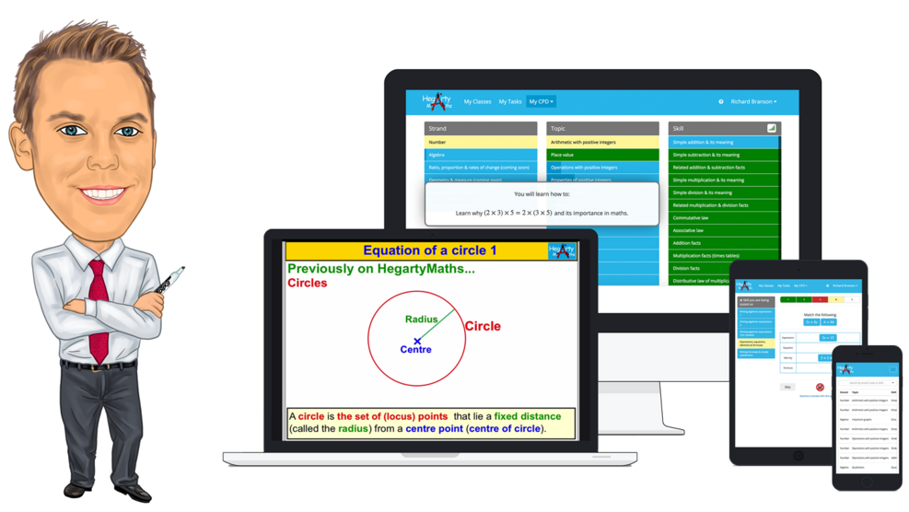
HegartyMaths ensures that when you are at home…
…You are NOT on your own and DO NOT have to feel stuck as ….
You have a teacher (Mr Hegarty) who will cover all the maths you need to learn in school.
Mr Hegarty will explain it to you and show you examples that will help you understand how to do the questions and be successful.
HegartyMaths will then let you practise examples like in the video so you can check you understand and can do it.

Slide 5
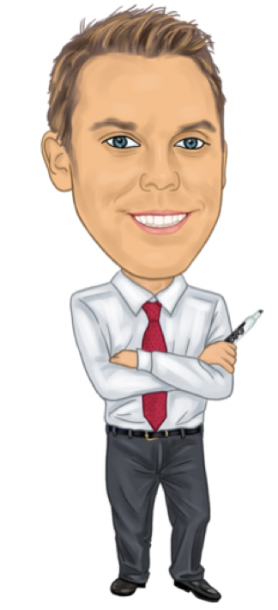
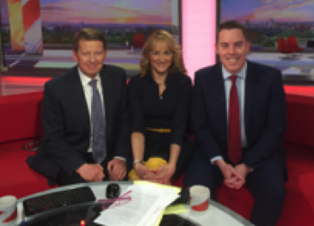

Who is this Mr Hegarty of HegartyMaths?
Mr Hegarty…
… loves maths and teaching it and knows that any student can do well in maths if they work hard.
… was the first person ever in his family to go to University where he got a First in Maths from Oxford University
(he believes he was not special or that clever -> he just had good teachers and worked hard!)
… became a secondary school maths teacher (his dream job!) as it was his ambition to help any student do well in maths.
… has won teaching awards and been on TV talking about how much he loves maths and wanting kids to do well!
Mr Hegarty meeting the Prime Minister with his students from Wembley.
Mr Hegarty on BBC breakfast and Good Morning Britain talking about maths.

Slide 6

Our weekly homework routines…
1 | You will always be set at least one homework a week by your teacher.
2 | Your teacher will choose the lesson they want you to learn and will pick it so that you are revising an important maths topic for revision. As such, you have already probably covered it in class but might have forgotten so your homework is to revise as, to be a great learner, you need to revise all the time (not just before tests!).
3 | You need to spend between 30 minutes and 1 hour on your homework as this shows effort and commitment and will ensure that you do quality homework.
4 | You will always be expected to watch the video + take notes; write down your quiz workings neatly; mark your own work, make corrections and write down your score at the end.
5 | Homework will be checked by your teacher in class once a week during your starter. You will be expected to bring your homework book to class and leave it open on the desk for your teacher to inspect.

Slide 7

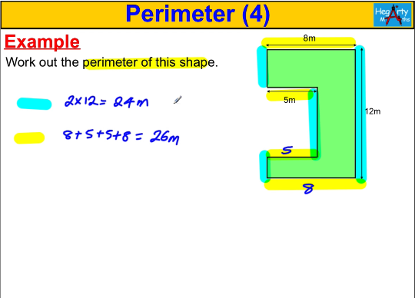
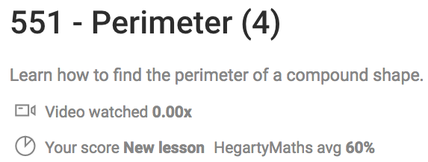


What does a homework on HegartyMaths look like?
Step 1:
Video where Mr. Hegarty teaches you everything you need to know about that topic & goes through all the examples that will be in the quiz.
Step 2:
Quiz that will allow you to practise all the examples in the video for yourself and know whether you understood what was in the video.

Slide 8
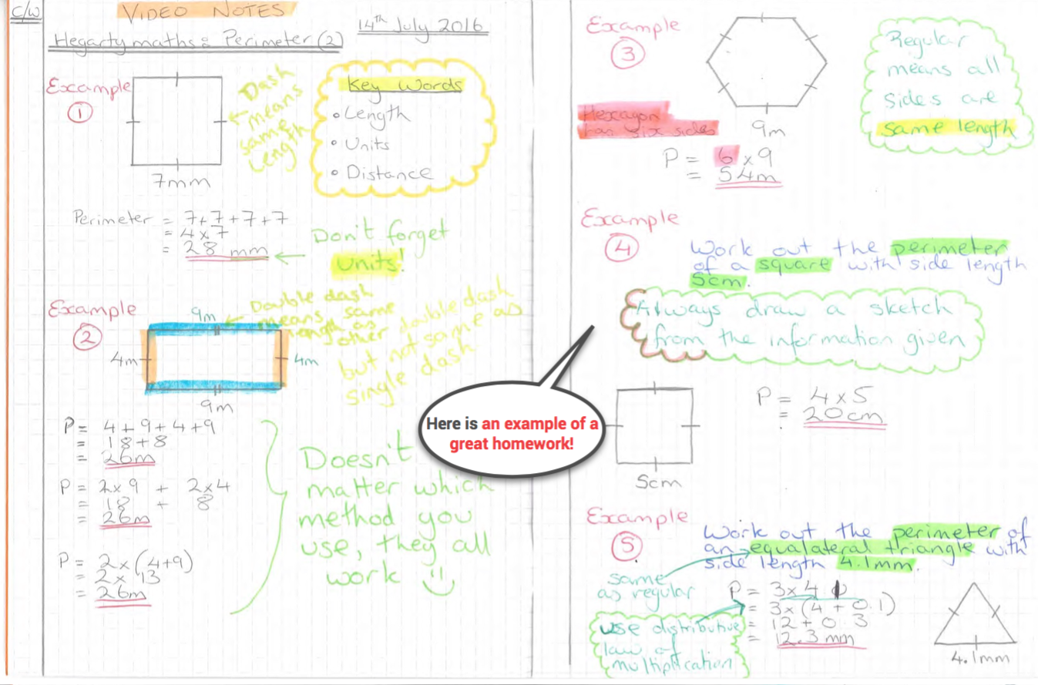
Step 1:
Watch the video, take notes of all modelled examples.
You will turn each video into fantastic notes in your HegartyMaths homework books.
You will always produce a set of well-written notes of all the modelled examples in the video as we want you to be an expert note-taker and to revise before you try the quiz. If you know the material, you still have to take the notes as sometimes you have to revise topics you already know and it’s good for your long-term maths memory.

Slide 9
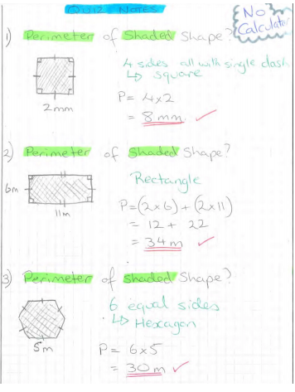
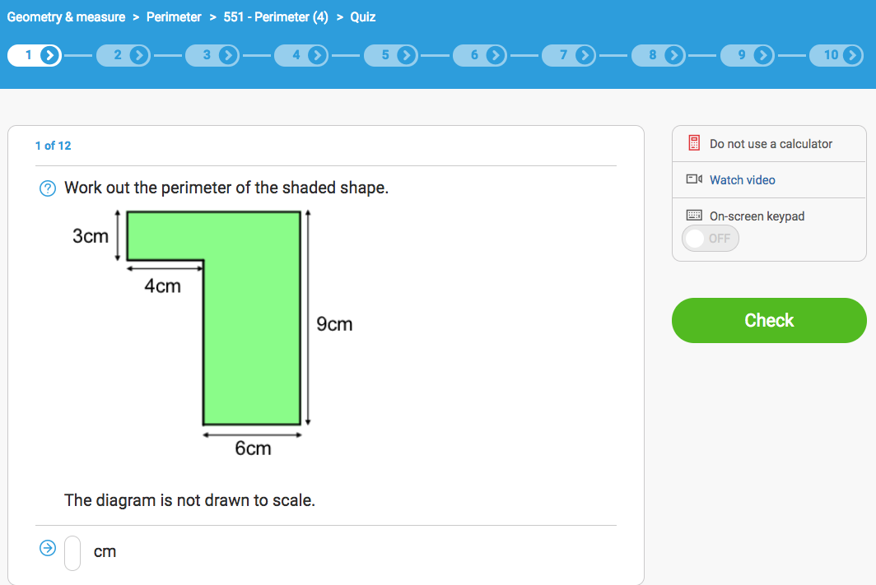
Step 2:
Assess your learning from the video in a quiz.
You need to:
Write down every Q
Always show all your workings
Always mark + self-correct your work
You will always show your workings and mark all questions you ever do. If you can do the question in your head you still need to show your workings as that is part of being a great mathematician.

Slide 10
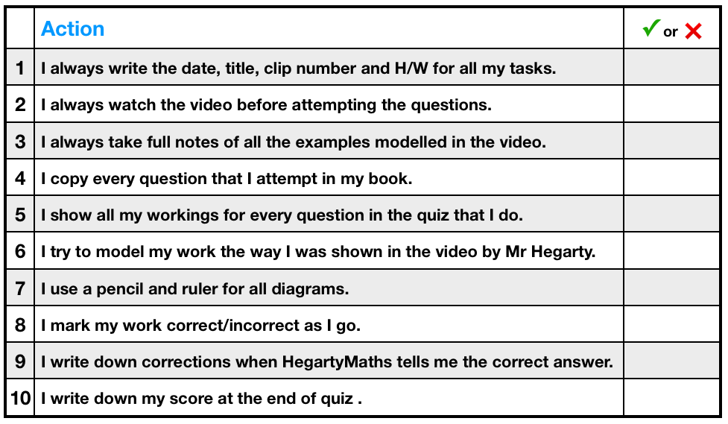
Student checklist for great weekly homework

Slide 11
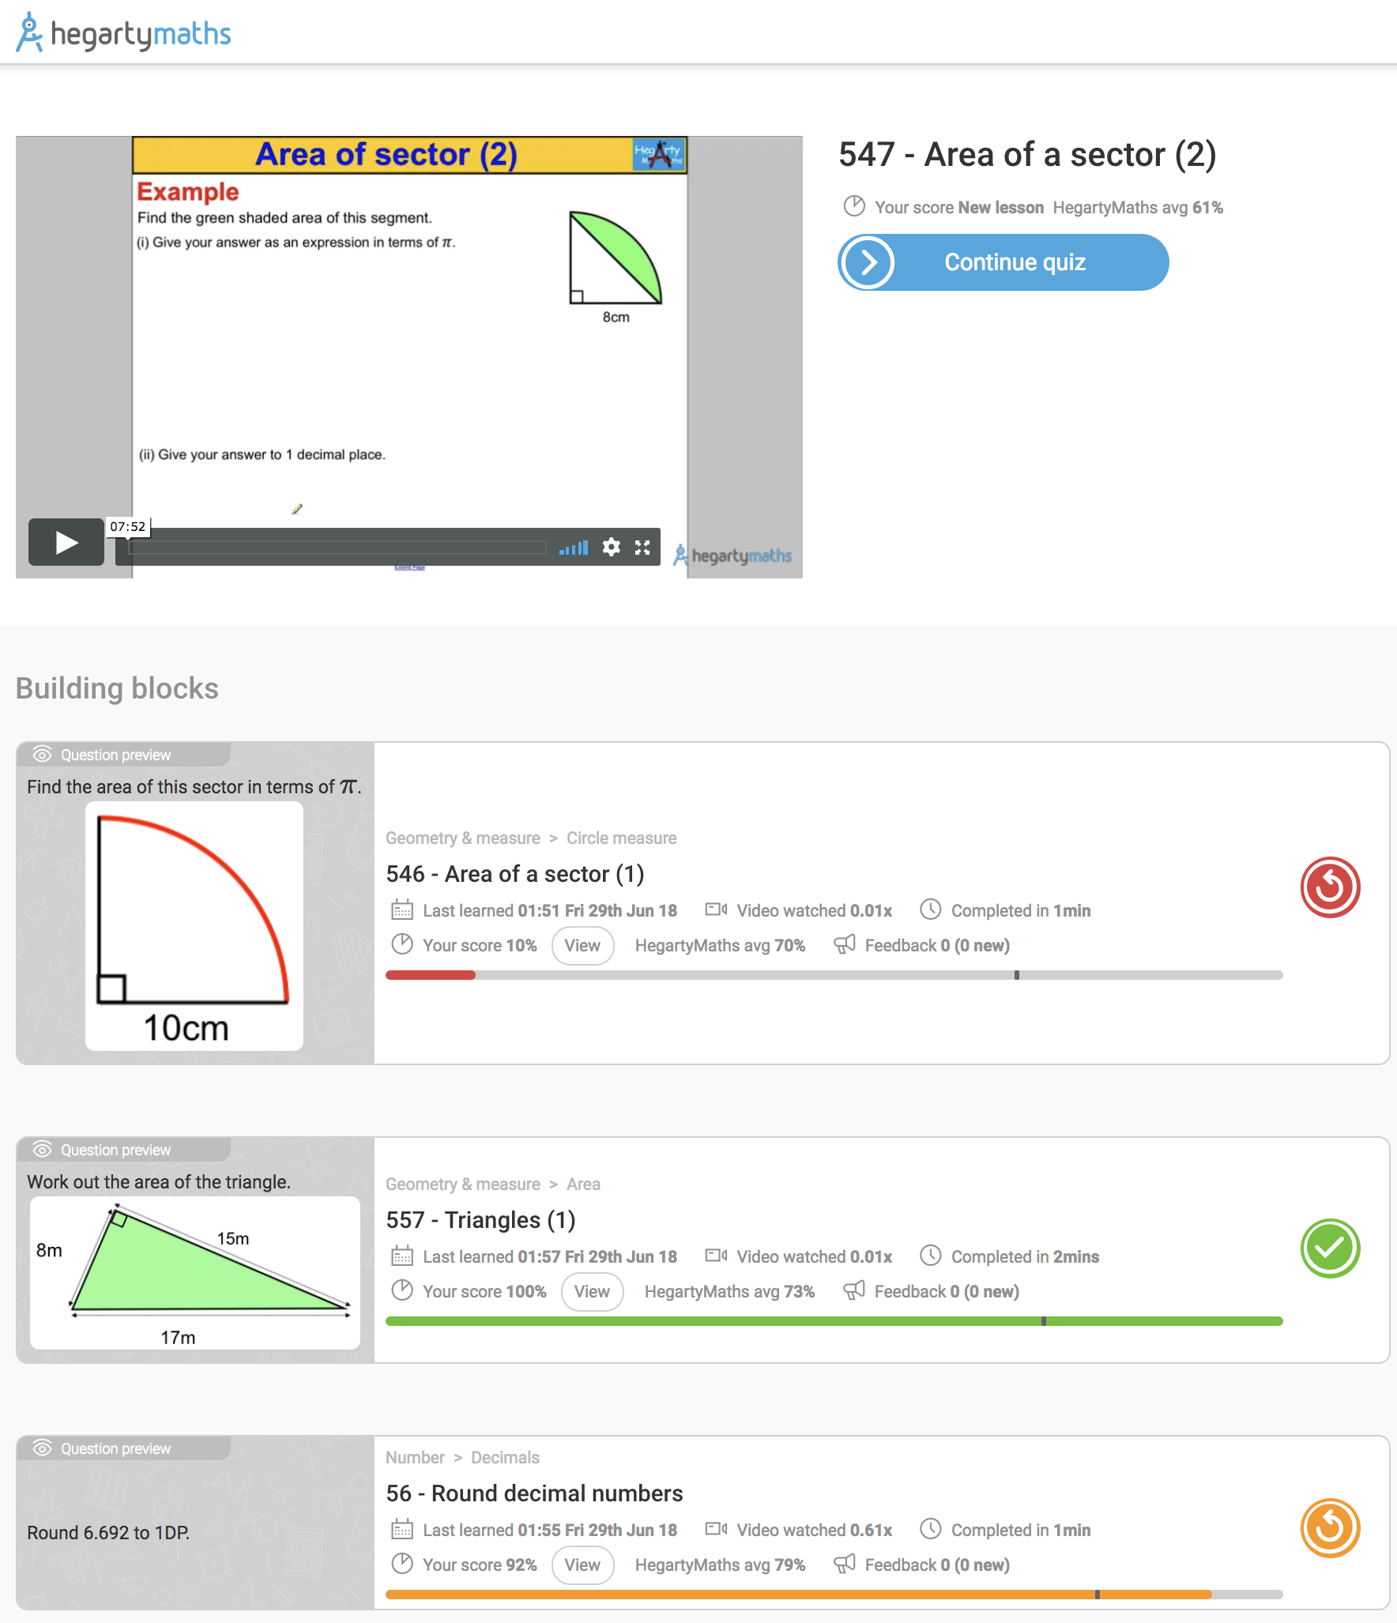
What to do if you are stuck?
1) Watch the video again really carefully ensuring all examples are copied and see if hearing and writing it down a second time helps.
2) Look at your building blocks. These are the lessons that will help you with your current homework. If these are not at 100% or less than the HegartyMaths avg. then you should redo those them as it will help on your current work.
In the picture, the student will struggle with homework 547 as they have only 10% on lesson 546.

Slide 12
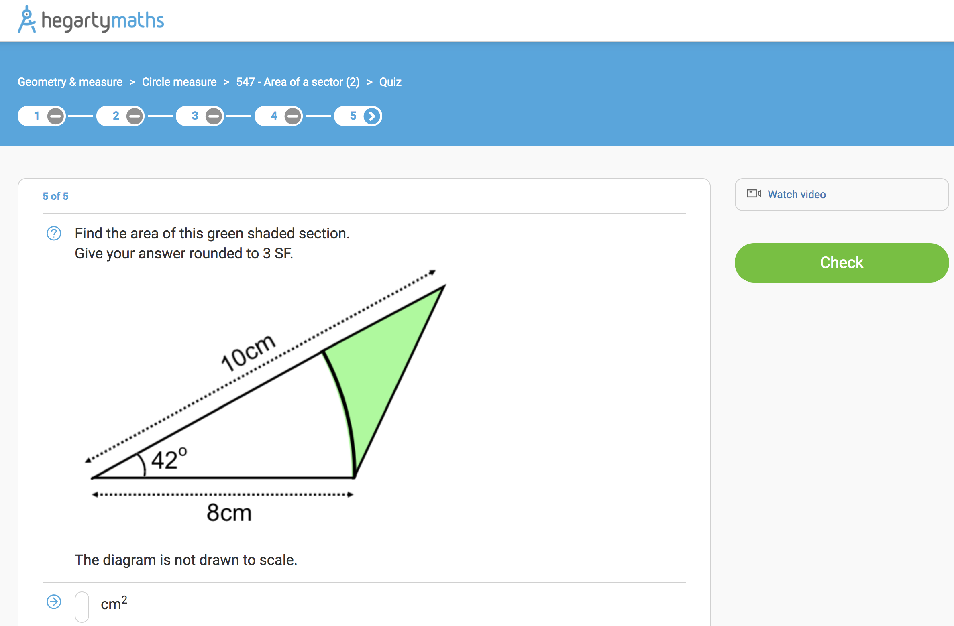
What to do if you are stuck?

Slide 13
What to do if you are stuck?

Slide 14
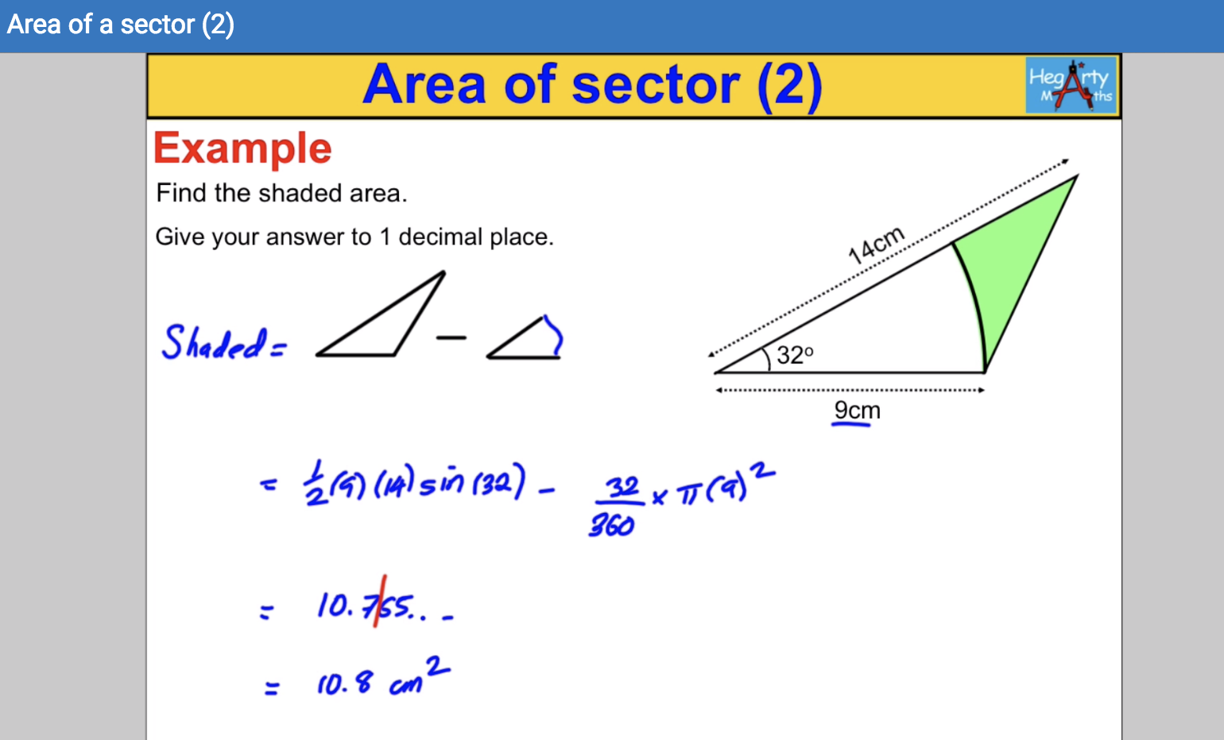
What to do if you are stuck?

Slide 15
What to do if you are stuck?
There will always be an example in video that will cover an almost identical question to the one you are stuck on.
You can also pull the video up in the quiz and scrub the video to the place that will help you on the one you’re stuck on.

Slide 16
Why do I have to always watch the video?
Ensures you will be successful: Watching the video will ensure you will do well in the quiz and feel good about your homework and maths. We don’t want you to feel like you’re on your own at home and the videos will give you the support you need to be successful with your homework.
Your memory: Copying down modelled examples helps you remember your maths and get it into your long term memory.
Method marks: Copying down modelled examples helps you practise how to lay our your maths properly to help you get questions correct and get extra method marks in exams even when you make mistakes.
Good revision: You are revising. When you are revising you sometimes have to look over material you already know – that’s good for you. Revision isn’t always just looking over stuff you struggle with.
Your teacher thinks it’s important: Each week your teacher will inspect the book to be sure you are practising how to write your maths down as this is just as important as attempting questions.

Slide 17
What happens when students decide not to watch the video?
Students get stuck and frustrated: Many students who just do the quizzes get really annoyed and frustrated with themselves as they make lots of mistakes and don’t understand why or how to get better.
Students stay at the same level: Students who just practise questions only get questions correct on topics they already know and they get questions wrong for topics they don’t know yet. They never improve. Watching the video means that for things you already know, you will secure that knowledge, and for things you don’t know yet, you can learn and get better.

Slide 18
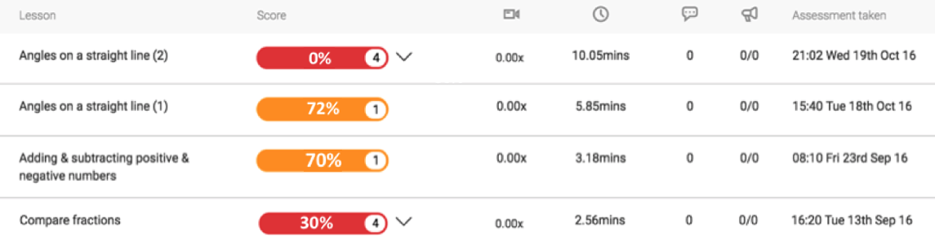
What happens when students decide not to watch the video?
“Mr Hegarty, I can’t do these homeworks as they are too hard and too I’m stupid!” (Hakim)
Very low scores
No video watched.
Spent only 2 mins quiz.
Hakim is upset and thinks he can’t do maths.
He is wrong - HE CAN DO MATHS!!!!
He is getting low scores as he is not watching the video or putting in enough effort.

Slide 19
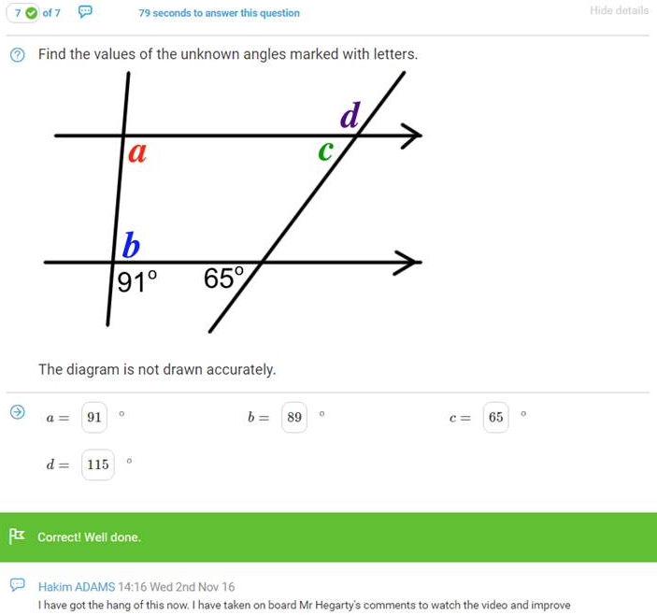
What happens when students decide not to watch the video?
Hakim smashes it!!!!!!!!!
Mr Hegarty reminded Hakim that he needs to spend longer on his homework, watch the video, take notes and write down all his workings. The next week Hakim completed a much harder homework, got it all correct and wrote back a comment to say thanks and he now knows how to improve and succeed.

Slide 20
What happens when students use Hegartymaths properly?
Students start enjoying maths and understand more in lessons.
Students like doing their homework as they feel successful.
Students do well in their exams.

Slide 21
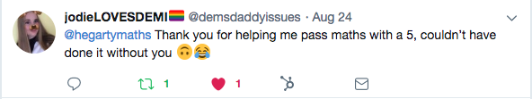
What happens when students use Hegartymaths properly?
Students start enjoying maths and understand more in lessons.
Students like doing their homework as they feel successful.
Students do well in their exams.

Slide 22
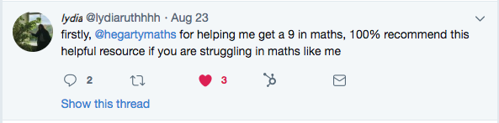
What happens when students use Hegartymaths properly?
Students start enjoying maths and understand more in lessons.
Students like doing their homework as they feel successful.
Students do well in their exams.

Slide 23
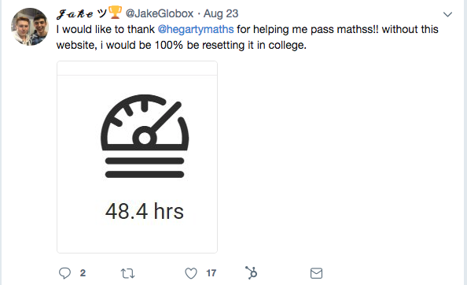
What happens when students use Hegartymaths properly?
Students start enjoying maths and understand more in lessons.
Students like doing their homework as they feel successful.
Students do well in their exams.

Slide 24
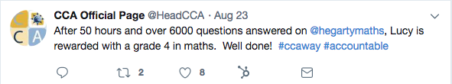
What happens when students use Hegartymaths properly?
Students start enjoying maths and understand more in lessons.
Students like doing their homework as they feel successful.
Students do well in their exams.

Slide 25
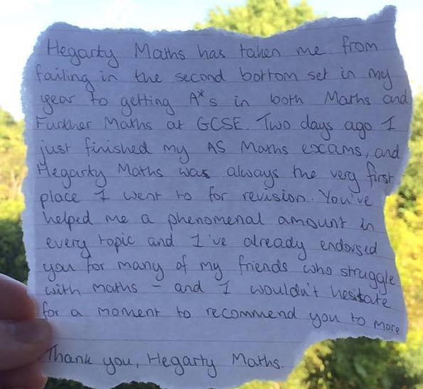
What happens when students use Hegartymaths properly?
Students start enjoying maths and understand more in lessons.
Students like doing their homework as they feel successful.
Students do well in their exams.

Slide 26
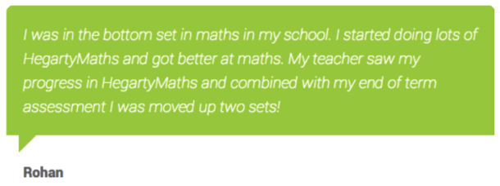
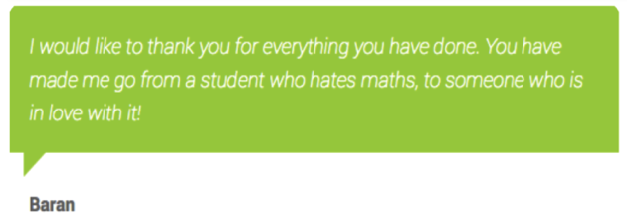
What happens when students use Hegartymaths properly?
Students start enjoying maths and understand more in lessons.
Students like doing their homework as they feel successful.
Students do well in their exams.

Slide 27
What happens when students use Hegartymaths properly?
Students start enjoying maths and understand more in lessons.
Students like doing their homework as they feel successful.
Students do well in their exams.

Slide 28
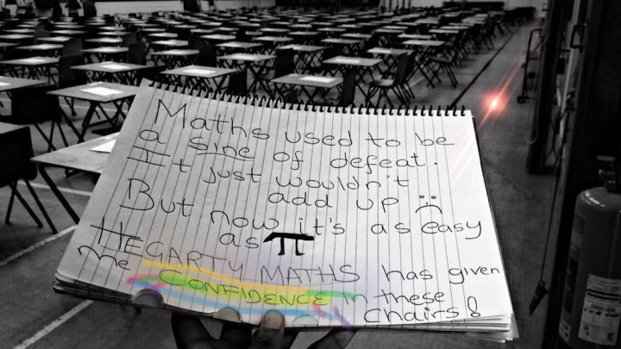
What happens when students use Hegartymaths properly?
Students start enjoying maths and understand more in lessons.
Students like doing their homework as they feel successful.
Students do well in their exams.

Slide 29
What happens when students use Hegartymaths properly?
Students start enjoying maths and understand more in lessons.
Students like doing their homework as they feel successful.
Students do well in their exams.
This girl spent 89 hours on quizzes, 14 hours on videos and 10 hours doing Fix Up 5. She completed all lessons on the site at 100% and got a grade 9 having been predicted a 5.

Slide 30
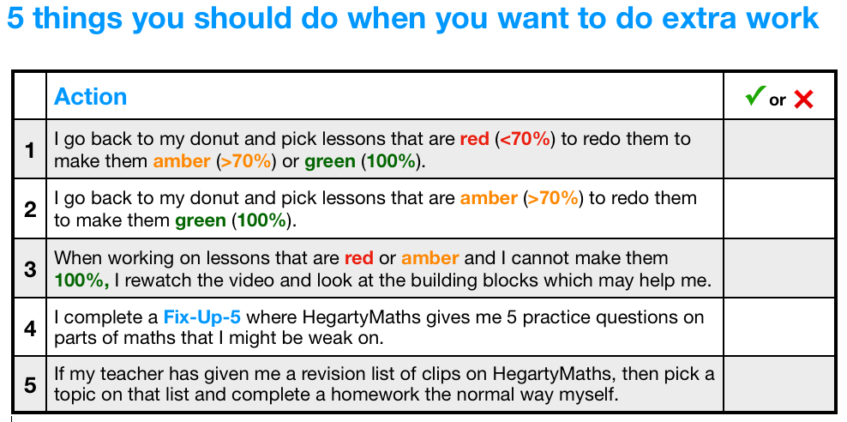
What if I’ve done all my homework – what else could I do?

Slide 31
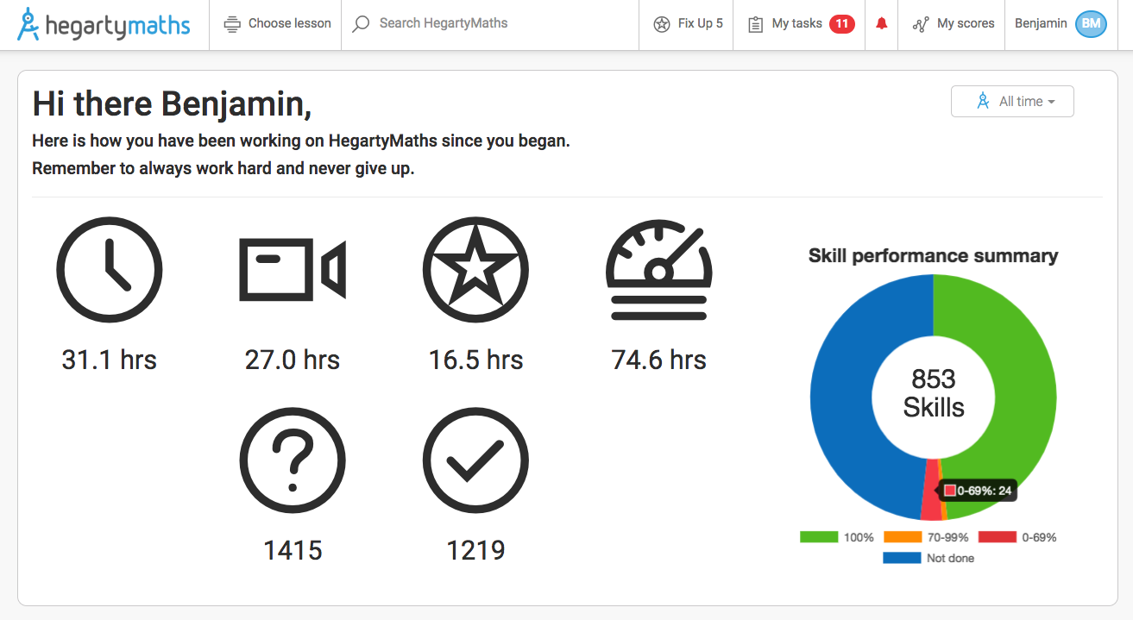
What if I’ve done all your homework – what else could I do?
1) Use your donut to improve your weak areas: Click the red section to find the quizzes you need to improve (quizzes under 70%) and redo them until they are amber (quizzes over 70%) or green (quizzes at 100%). Once you have made everything green or amber go back over the amber and try to get them to green.
Click the red section and it will open up any lessons you are under 70% on for you to redo. Here, you have 24 lessons you could improve that are red (under 70%).

Slide 32
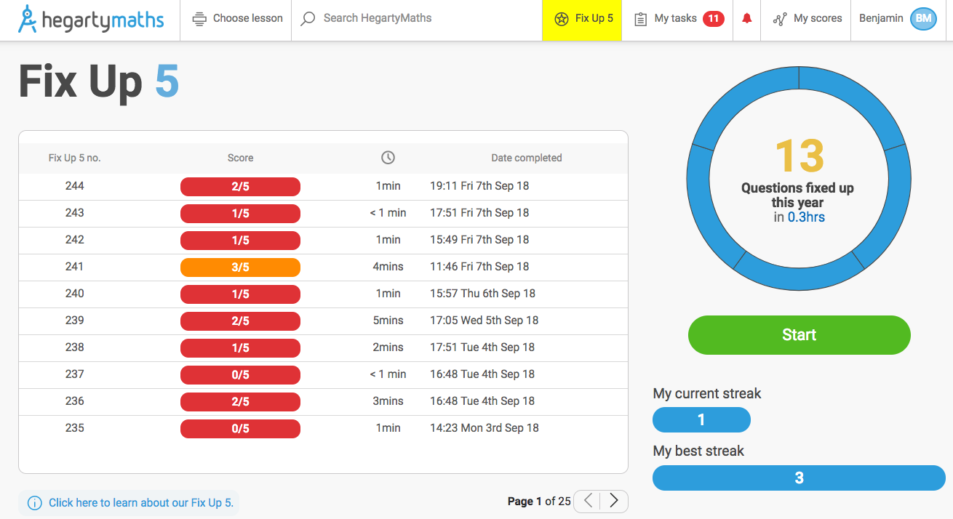
What if I’ve done all your homework – what else could I do?
2) Fix up 5: HegartyMaths remembers every mistake you have ever made and generates a quiz with 5 questions from different parts of maths that you are weak on so you can re-do them with the video and Fix Up!

Slide 33
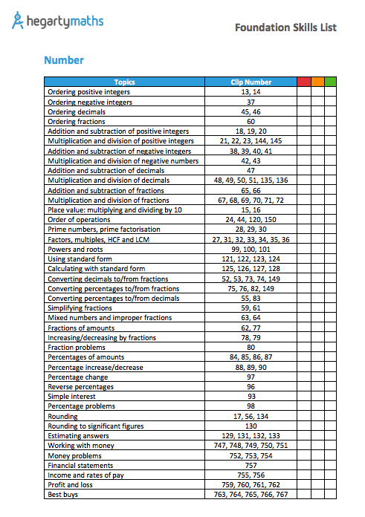
What if I’ve done all your homework – what else could I do?
3) Learn a new section: Your teacher may have given you a revision list of clips so you can now use that to find a clip on HegartyMaths that is appropriate for you. Watch the video and do the quiz for a clip you haven’t done before.

Slide 34
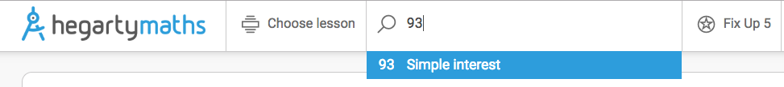
What if I’ve done all your homework – what else could I do?
3) Learn a new section: Your teacher may have given you a revision list of clips so you can now use that to find a clip on HegartyMaths that is appropriate for you. Watch the video and do the quiz for a clip you haven’t done before.
If you want to learn Simple interest type clip number 93 into the Search Bar

