Slide 1
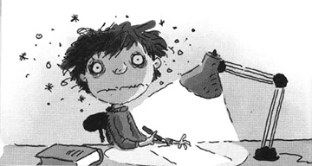
Homework, I love you. I think that you’re great. It’s wonderful fun when you keep me up late. I think you’re the best when I’m totally stressed, preparing and cramming all night for a test.
Homework, I love you. What more can I say? I love to do hundreds of problems each day. You boggle my mind and you make me go blind, but still I’m ecstatic that you were assigned.
Homework, I love you. I tell you, it’s true. There’s nothing more fun or exciting to do. You’re never a chore, for it’s you I adore. I wish that our teacher would hand you out more.
Homework, I love you. You thrill me inside. I’m filled with emotions. I’m fit to be tied. I cannot complain when you frazzle my brain. Of course, that’s because I’m completely insane.
Kenn Nesbitt
Notes:
I put this poem in because it resonated with me on many levels. I see the enthusiasm in my little girl now that she has started to get “proper homework” and we want our students to be alive with curiosity. I’m sure we can all relate to the thrill of being in the zone and loving learning. Again something we want to encourage in our learners but we certainly don’t want to drive them “insane” and as teachers and parents we have a responsibility to ensure our students are fully supported in their learning journey and that we are developing the whole person.

Slide 2
HOMEWORK
To know why we set homework
To understand the different types of tasks we set and the challenges students face
Identify ways in which school and parents can better support students in their homework and assessments

Slide 3
Why do we set homework?
Raise achievement
Consolidate knowledge
Extend learning
Encourage curiosity and research skills
Develop lifelong independent learners
Develop study and work routines
Notes:
Develop point about extended learning and whole school initiative on allowing for stretch and challenge in homework tasks.
Explain curiosity challenge and take an example.

Slide 4
‘I have a dream…’ Homework
All complete the 1 chilli work.
Listen to/read Martin Luther Kings speech.
http://www.americanrhetoric.com/speeches/mlkihaveadream.htm
Answer: what was King’s dream for the future?
What do you believe are the most powerful parts of the speech? Explain why those parts are powerful.

Slide 5
What types of homework are set?
Short Tasks
These should take no longer than 30 minutes.
Research: sometimes students are asked to write something in their books, sometimes they are not. Staff will make this clear. This is normally to extend students knowledge from their lesson or to prepare pupils for next lesson.
Written: answers to questions or other written tasks
Posters/Pictures: To summarise or consolidate knowledge, extend artwork
Prepare presentations/speeches/video’s
Craft: To make a model, mask, wooden spoon puppet etc…
Long Tasks
Projects: longer pieces of work that pupils need to complete over a number of weeks
Booklets prepared on a particular topic
Prepare presentations/speeches/video’s
Craft: To make a model, mask, wooden spoon puppet etc…
Revision

Slide 6
How is homework set and recorded?
Homework will be displayed by the teacher with a date due in lesson time.
The subject and due date should be recorded in the planner. Teachers will give assistance if pupils need help writing it in.
Teachers will also record homework on “Insight” which you can check and print out.

Slide 7
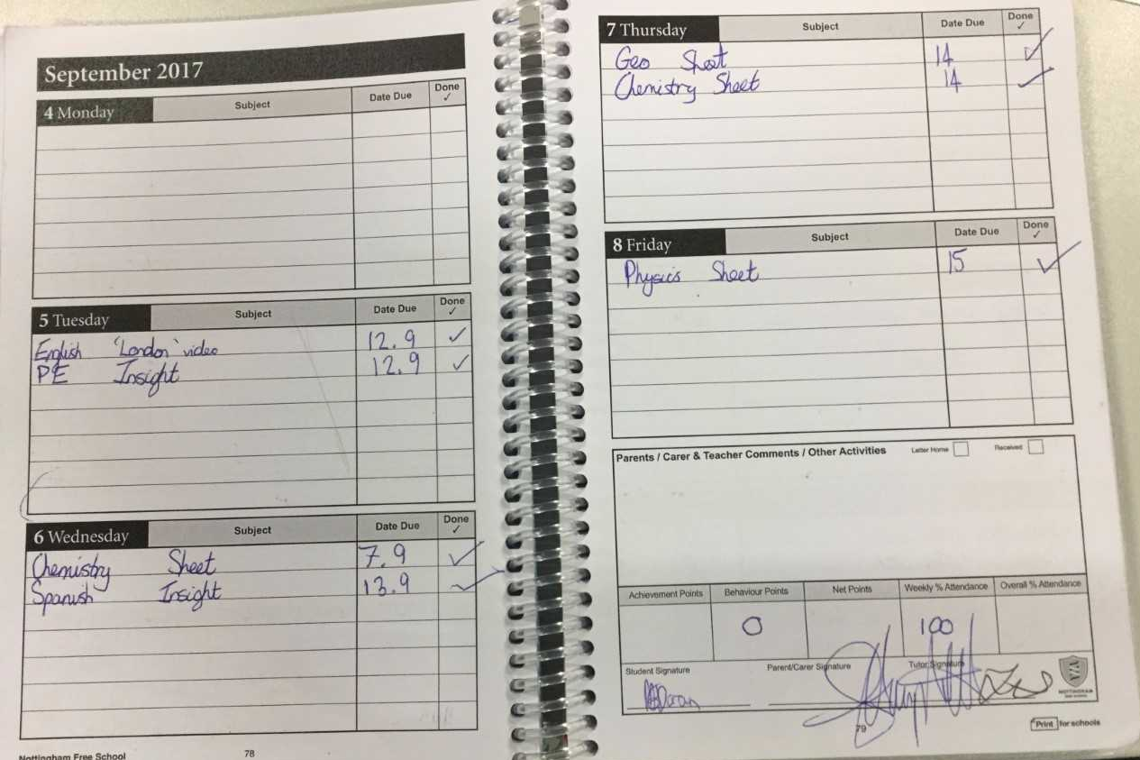

Slide 8
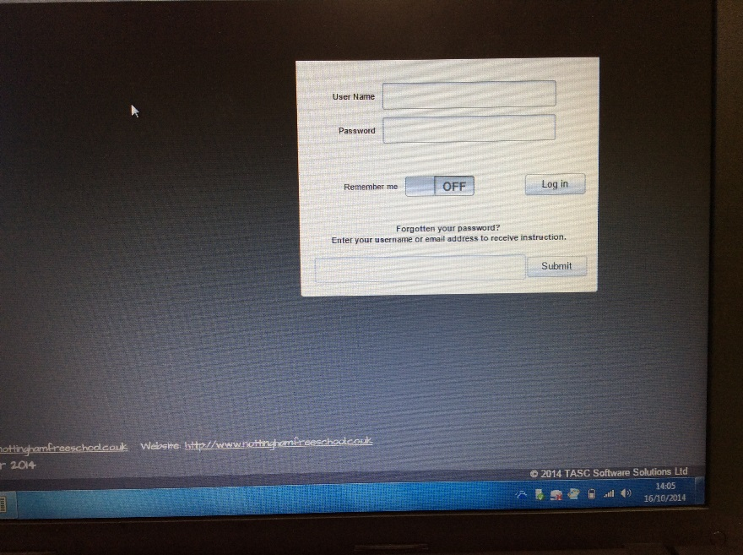
Insight

Slide 9
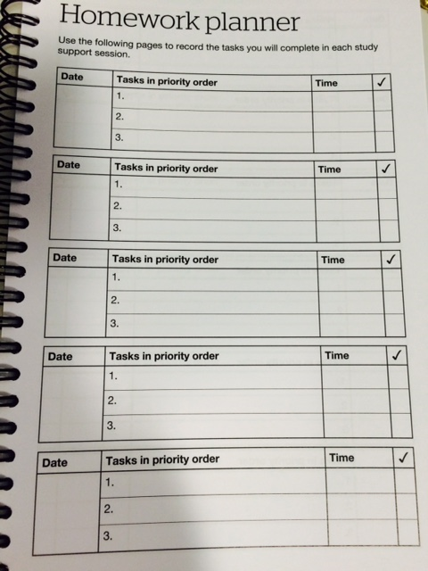
How do students organise their homework?
In the front of the student planner there is a section to help students organise their homework in study support.
This is also a good place for you to check what they have been doing in study support.
Notes:
Some parents have complained that students don’t take anything home as they have completed all homework in school. This should not be possible and I would ask them to see the homework as it is probably rushed and not good quality.

Slide 10
What happens if homework is not done?
If homework is not completed by the deadline a detention is set
If this continues you will be contacted and students will have further consequences.

Slide 11
Why is it important for parents to be involved in homework?
Studies in Britain have shown that children who are supported by their families with homework are likely to perform significantly better in academic examinations at 16 years old and beyond than those who do not.
By showing an interest you are communicating the fact that school work is important and needs to be taken seriously.

Slide 12
Assessment
To know why we hold two assessment windows each year
To understand the procedures for assessments and the support that will be offered to students
Identify ways in which we can support students to best revise for assessments

Slide 13
Assessment weeks & revision
house noodles envelope
goat rat sharp
telephone hat tree
book orange letter
worm post-it banana
slowly potato stamp
aeroplane coat badge

Slide 14
Assessment weeks
Why?
To check understanding and progress
To re-set if needed
To teach students necessary revision skills to meet the needs of the new GCSEs
When?
Twice a year
What?
A test for each subject, in test conditions.
How?
Main hall or classroom (for practical assessments)

Slide 15
January 2017 – Assessment week
Year 7
Week commencing: Monday 16th January 2017
Year 8
Week commencing: Monday 23rd January 2017

Slide 16
Revision Preparation in school
Study support session to introduce revision skills, go through revision pack and construct revision timetable
Revision pack includes:
Assessment timetable
A revision booklet

Slide 17
‘I can….’ statements
Each subject has provided a list of ‘I can…’ statements. Your aim, by the end of the revision period, is to be able to do all of the ‘I can…’statements. This will mean that you are fully prepared for your exam.
Each time you cover an ‘I can….’ statement, you need to put a tick in the box next to it. You should aim to cover each statement 3 times in your revision.

Slide 18
Key terms and definitions
Each subject has provided a list of key terms which are vital to you achieving good grades in each exam.
You need to write down the definition for each of the key terms in the table. You can then revise this list.

Slide 19
Each subject has a memorisation box. This shows the key information that you will need to memorise in order to be successful in the exam
There is also a box to show the best revision techniques for each subject. Try to use these techniques where possible.

Slide 20
Revision Preparation in school
Revision Preparation in school
There will be an assembly during study support on Thursday 30th December for Year 7 and Year 8. This will be to introduce them to exam timetables and revision guides
Copies of all documentation will go into the revision centre on the school website
All study support sessions, homework tasks and PSHCE lessons will be focused on revision
Mindfulness activities every day w/c 9th January to help students deal with stress or anxiety

Slide 21
How can you help?
Or how to turn this…
… to this
Notes:
Now the irony of this presentation is that I tried to prepare this as my daughter sat down to do her homework and the result was much more of the top picture than the bottom
So I hope you appreciate that we are not out to preach or patronise. Many of us have children ourselves and experience all of the frustrations that you may do with homework. We may know all of the theory of creating the perfect harmonious homework situation but we also experience the reality.
So you may already do many of the strategies that I’m going to talk through or there may be little nuggets that you want to try.
It might be that there is nothing new in this for you at all and it simply serves as a reminder or a confirmation that you are doing the right thing.

Slide 22
How can you help?
Reinforce our message of ‘try your best, be prepared and don’t worry!’
Give them a quiet place in the house without distractions so they can focus.
Communicate with their tutor if you have any questions or need to pass on any concerns.
Check the blue homework folder and check planner/Insight on a regular basis

Slide 23
How can you help with assessment preparation?
Take an interest in their revision matrix and help them to ensure they are not spending too much time revising one subject and not enough revising another
Help them with revision by testing them, getting them to explain things to you etc.
Ensure they get a balance between revision and rest.
During the assessment week, sleep and breakfast are very important!
Check they have the correct equipment: clear pencil case, pens, pencils, ruler, rubber, sharpener and
calculator

Slide 24
We understand!
Family life is very busy
Good communication is vital
It’s a joint effort

