Slide 1
Nottingham Free School Introduction to 2018 DofE Expeditions Bronze & Silver Steve Wilkins Managing Director, Karos Adventure

Slide 2
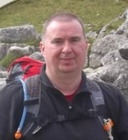
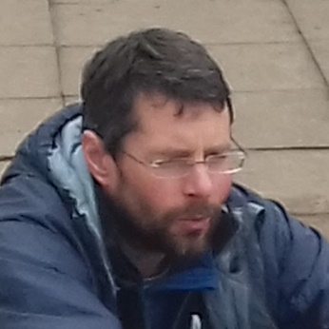
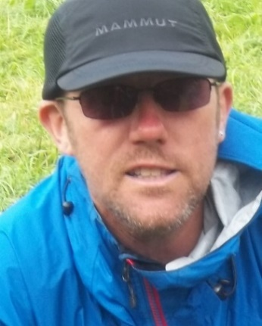
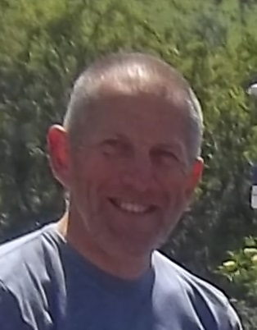
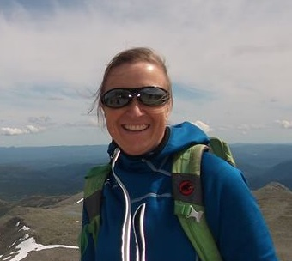
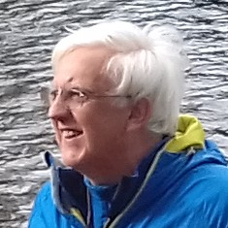
About us
Karos Adventure …
A family-run company, based in Uttoxeter, Staffs.
Bronze, Silver, Gold Award holder
30 years DofE experience nationwide.
Work with 20 schools & 750 young people per year.
Our Expedition Leaders ….
hold National Governing Body (NGB) qualifications.
hold an up-to-date First Aid Qualification suitable for remote outdoor working.
are subject to an enhanced DBS check.
have many years experience in DofE.
are DofE Accredited Assessors.
have a passion for working in the outdoors with young people.
are friendly and supportive.

Slide 3
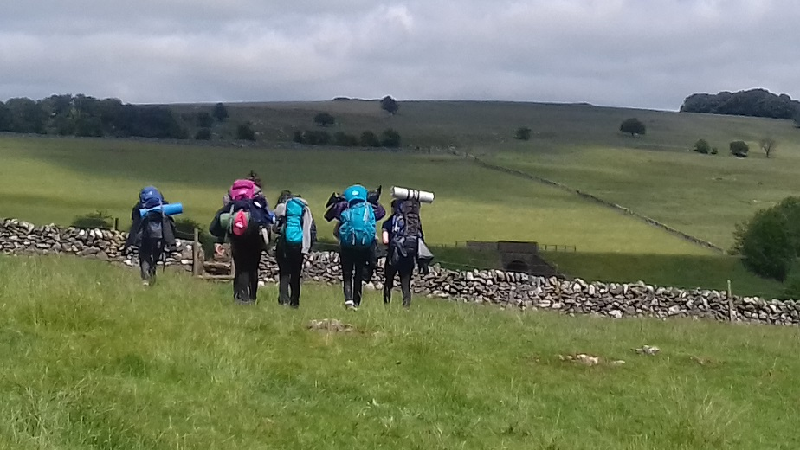
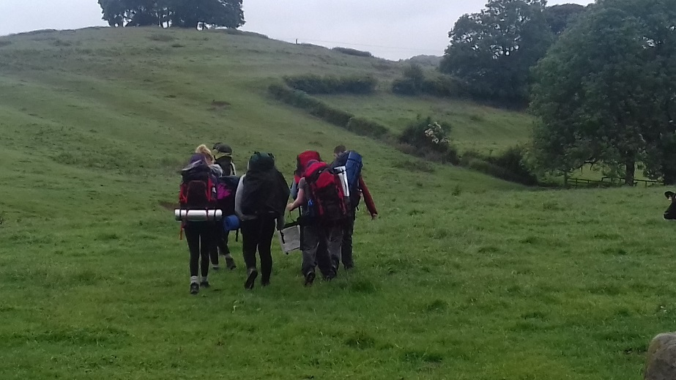
What is a DofE Expedition?
Participants undertake a journey as part of a team.
Fully trained to deal with all eventualities.
Unaccompanied (leaders & teachers meet them at set locations, including camp).
Remotely supervised and assessed.
Self-sufficient – carry everything with them that they will need.
Has an aim - “A Journey with a Purpose”.
Camping and catering for themselves.
Minimum number of 6 hrs (B) / 7 hrs (S) journeying (“Planned Activity”) each day.
Present what they have learnt.

Slide 4
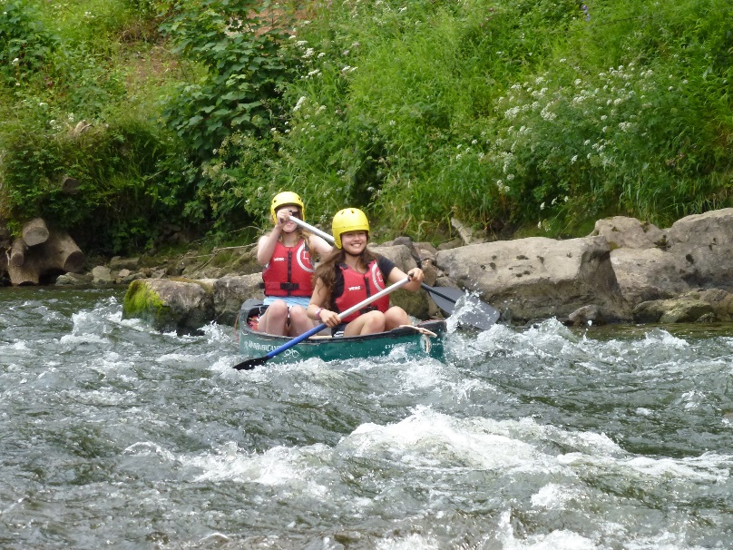
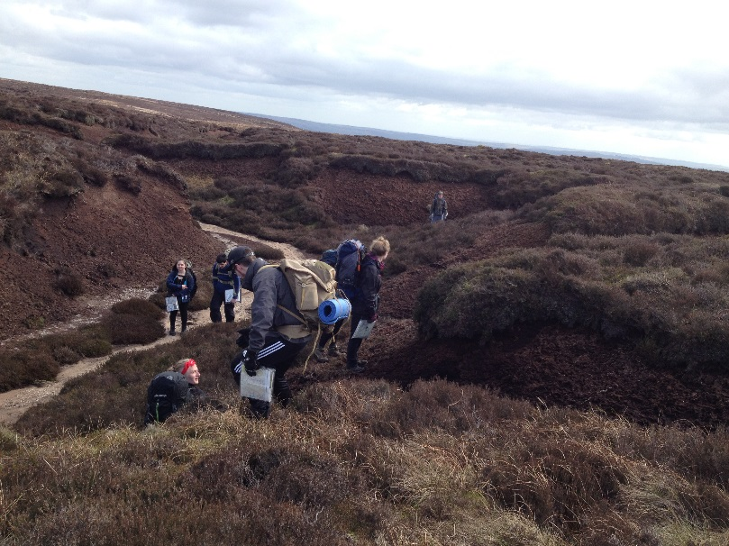
How do we ensure safety?
Approved Activity Provider and AALA License.
Leaders - qualified, friendly, supportive, DBS.
Risk Assessments.
Public Liability Insurance of £10million.
Regular review and maintenance of equipment.
Emergency Contact details.

Slide 5
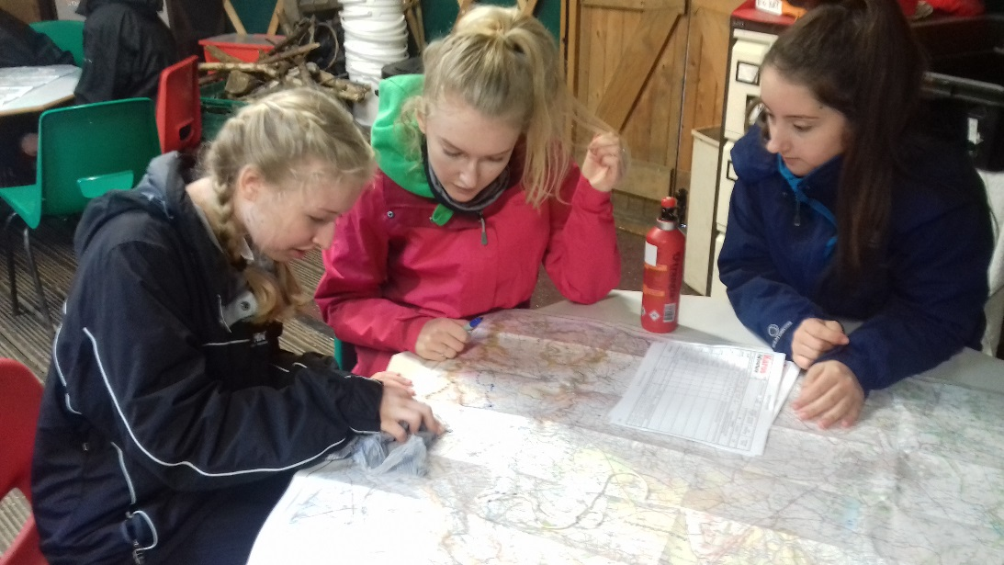
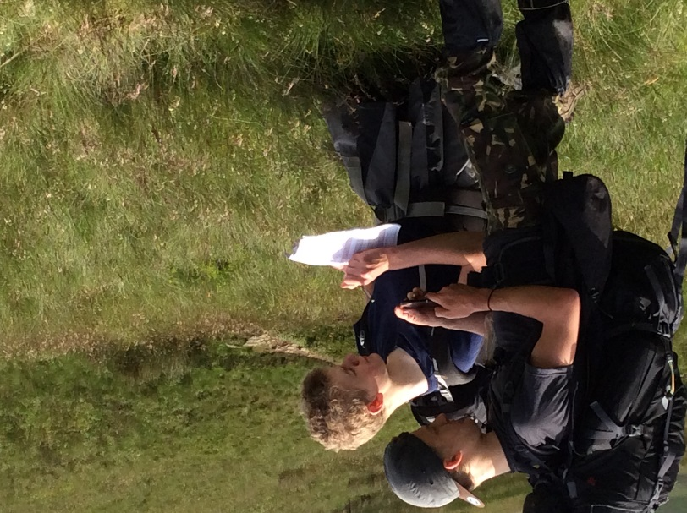
How do we keep you informed?
Joining Instructions issued before each event.
Web site – download resources & factsheets.
Kit Lists – handouts available.
Updates on Facebook and Twitter.
Extra info – travel updates, expedition progress.
Home Contact for emergencies.

Slide 6
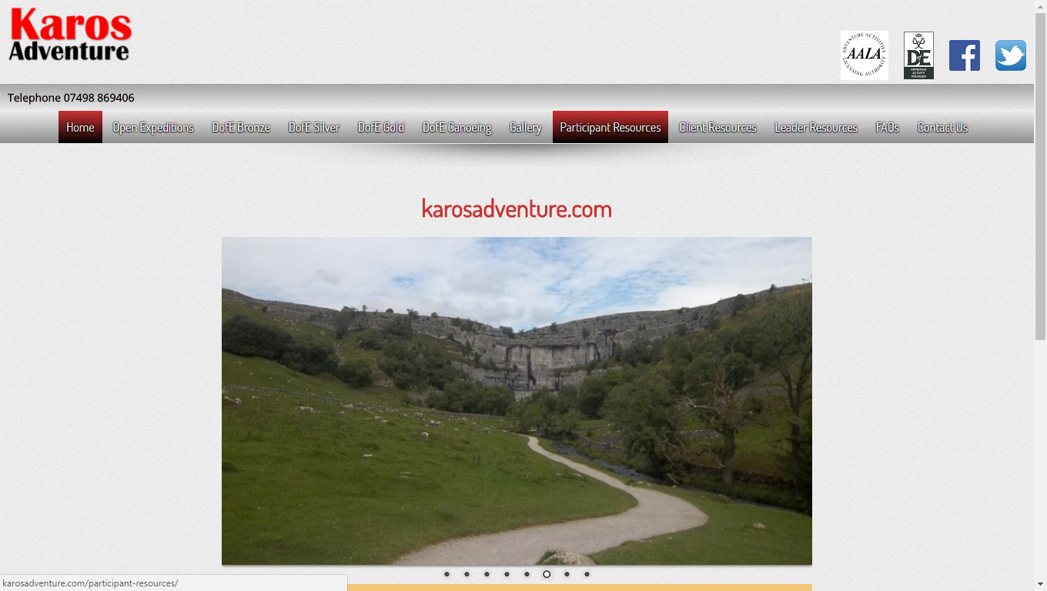
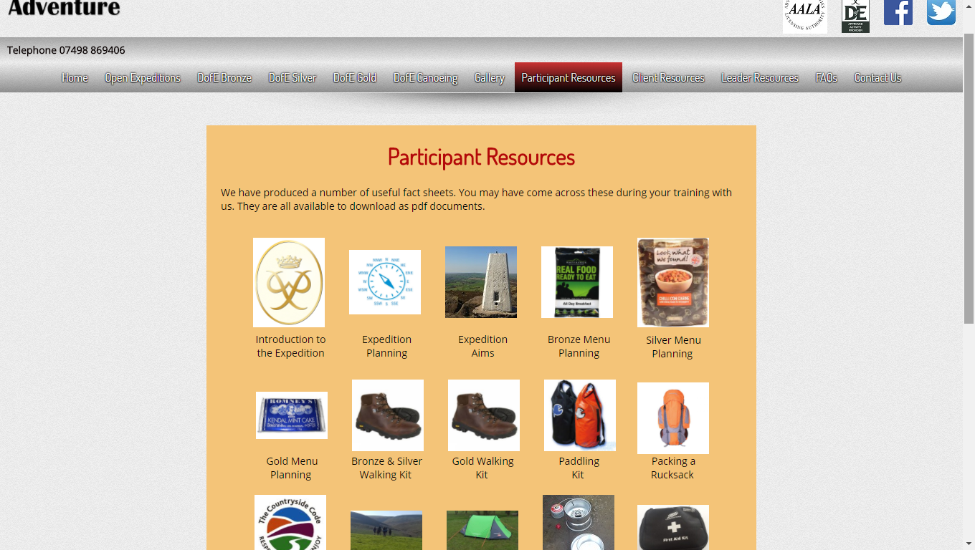
Factsheets
Factsheets available on our web site www.karosadventure.com
Cover range of subjects including, first aid, emergency procedures, food & menu planning, kit lists, general expedition hints and tips.
Password to access:
Username = Karos
Password = Award

Slide 7
Mobile Phones
OS Locate
Free app.
Download before expedition.
Use in an emergency.
Provides accurate Grid Reference.
Should only be used in an emergency.
Switched off and sealed in a bag.
Emergency Safety Card with contact numbers.
Only to contact Supervisor, Home Contact or 999.
In an emergency, phone or text location and situation to Supervisor and Home Contact.
Keep phone switched on until otherwise informed by your Supervisor.

Slide 8
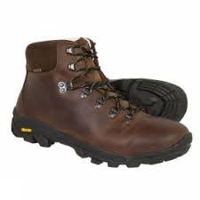
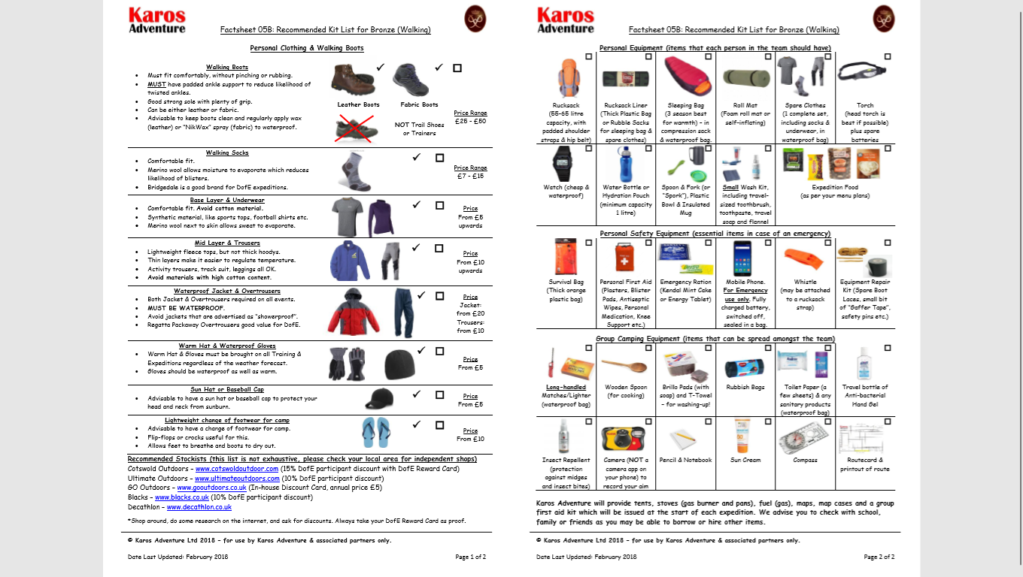
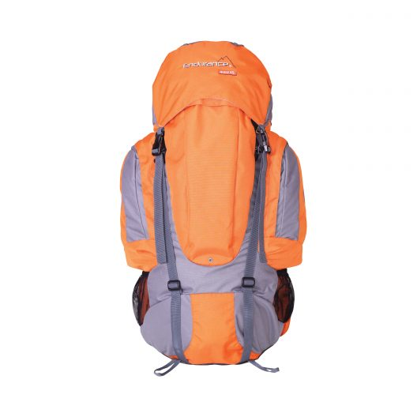
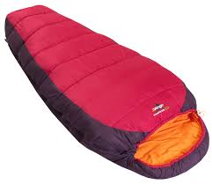
What kit will they need?
We will provide… Tents Stoves OS Maps Map Cases Fuel – Gas Group First Aid Kit | Participants will need … Walking Boots Personal Expedition Clothing & Items Rucksack Sleeping Bag Group Items (T-Towel, Brillo, matches etc.) Food

Slide 9
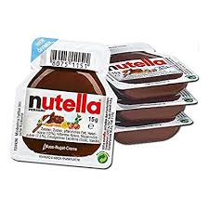
What will they eat?
Breakfast – porridge, cereal bars, scotch pancakes, honey.
Evening Meal – soup, pasta & sauce, rice & curry, cake & custard.
Lunches – flatbreads or oatcakes, preserves, flapjacks, biscuits.
Snacks – raisins, sultanas, energy sweets, jelly, Haribos.
Water – at least 1 litre carrying plus 1-2 litres refilled during the day.
Emergency Rations – Kendal Mint Cake or Dextrose Tablets.
Avoid: Meat, Dairy, Tins, Bottles/Jars.

Slide 10
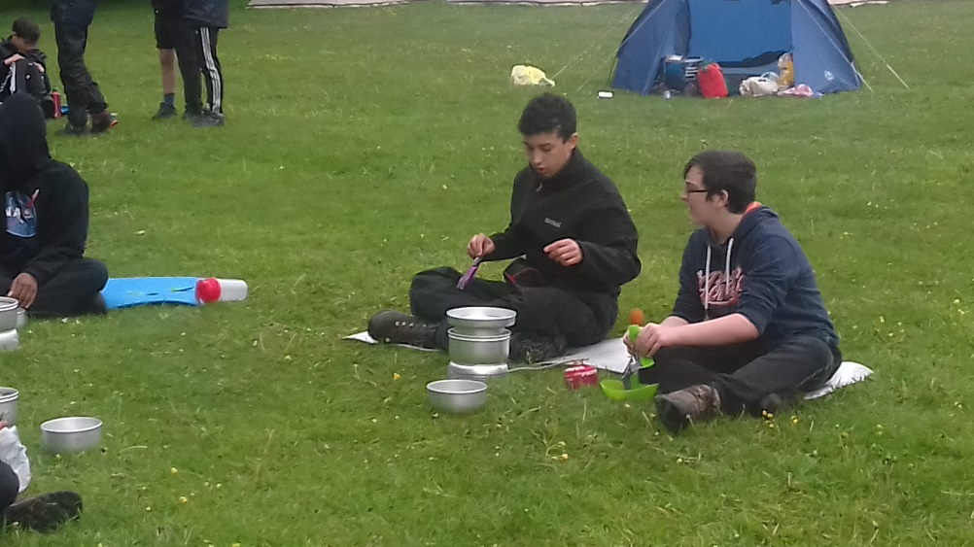
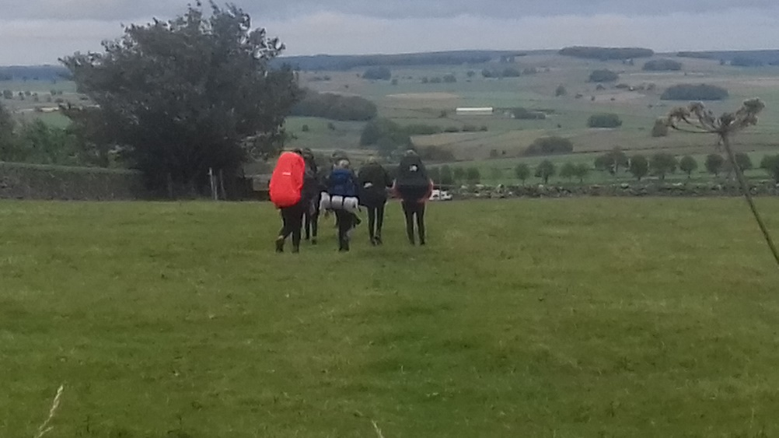
2018 Key Dates : Bronze
Sat 12th – Sun 13th May: Residential Training (Beaumanor Hall, Leics)
Sat 6th – Sun 7th July: Practice Expedition (Peak District)
Sat 21st – Sun 22nd July: Qualifying Expedition (Peak District)

Slide 11
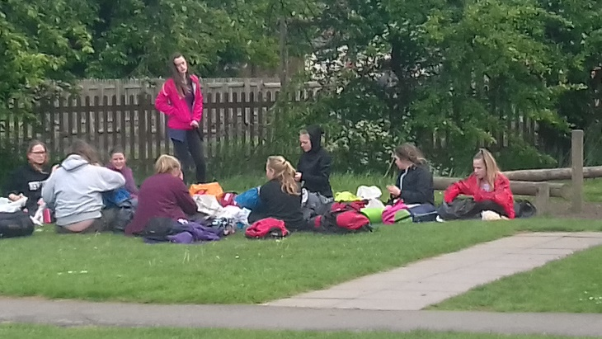
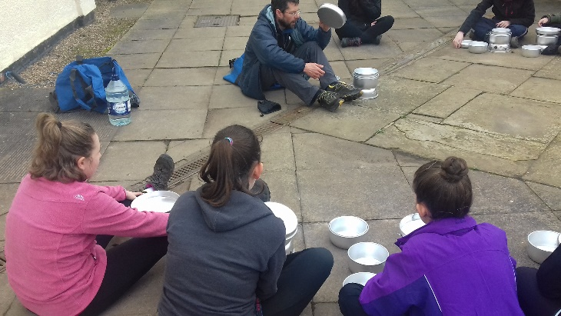
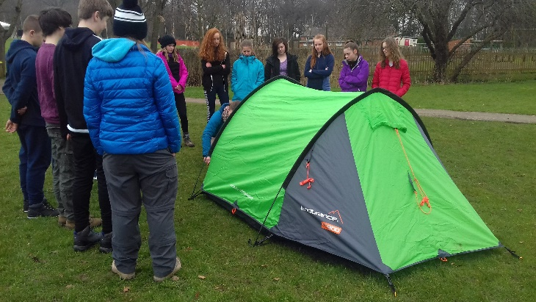
Residential Training: Bronze
2-day, 1-overnight camp based at Leics County Council OEC at Beaumanor Hall, Woodhouse, Leicestershire (Bradgate Park area).
1 day walking, accompanied by KA Leader, training in Navigation, First Aid, Emergency Procedures, Safety & Countryside Code.
1 day on-site, planning expeditions and review of kit and food.
Overnight camp, including training on campcraft & cooking.
Need all kit and food as per expedition (Lunches, Snacks, Water, Sat Evening Meal & Sun Breakfast).

Slide 12
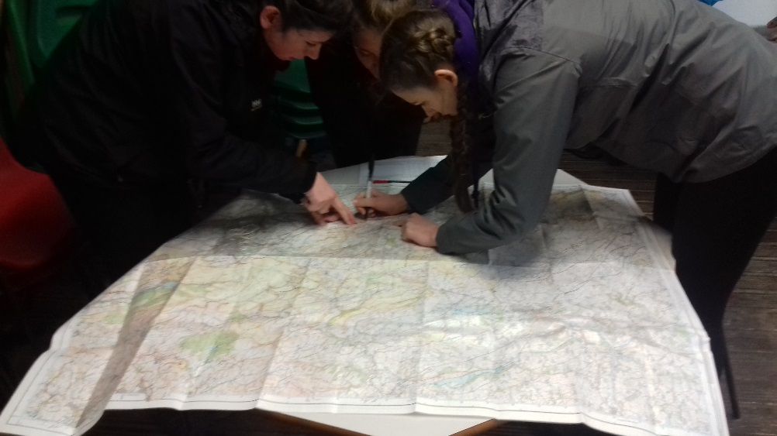
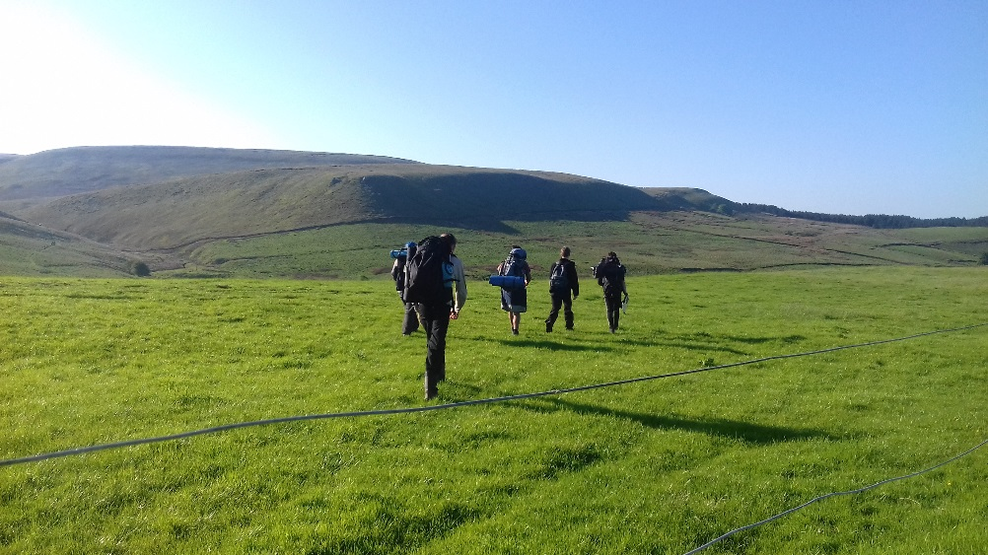
2018 Key Dates : Silver
Mondays weekly from 16th April: In-school Planning Sessions
Sat 28th April: Navigation Training, Longshaw Estate, nr Hathersage
Fri 6th – Sun 8th July: Practice Expedition (Peak District)
Fri 20th – Sun 22nd July: Qualifying Expedition (Peak District)

Slide 13
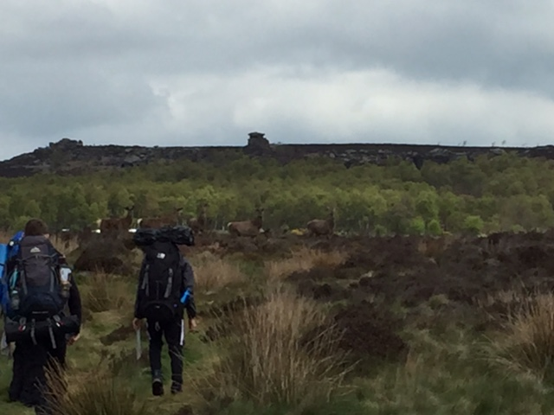
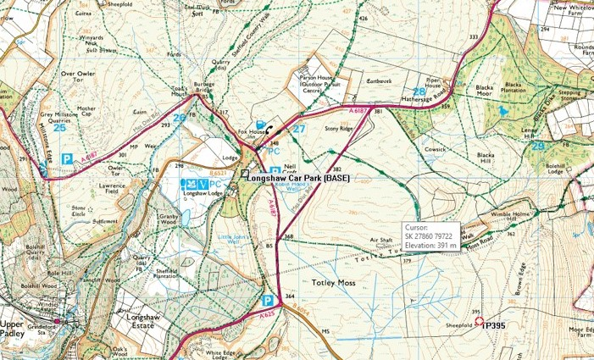
Navigation Training: Silver
Navigation Training Day at Longshaw Estate, Owler Bar Road, Fox House - NT property and land just off junction B6521 & A6187.
Navigation in open moorland, Compass Bearings, Countryside Code, Rights of Way, First Aid, Emergency Procedures, Safety.
Day Pack, waterproof jacket & trousers, hat & gloves, lunch & water.

Slide 14
The other sections
Bronze
In the meantime, ensure you start work also on the other sections…
Volunteering – 3 months
Skills – 3 months + a further 3 months in any section.
Physical – 3 months
… and upload your evidence onto eDofE!!!

Slide 15
The other sections
Silver
In the meantime, ensure you start work also on the other sections…
Volunteering – 6 months
Skills – 3 or 6 months (switch with Physical)
Physical – 3 or 6 months (switch with Skills)
… and upload your evidence onto eDofE!!!

Slide 16
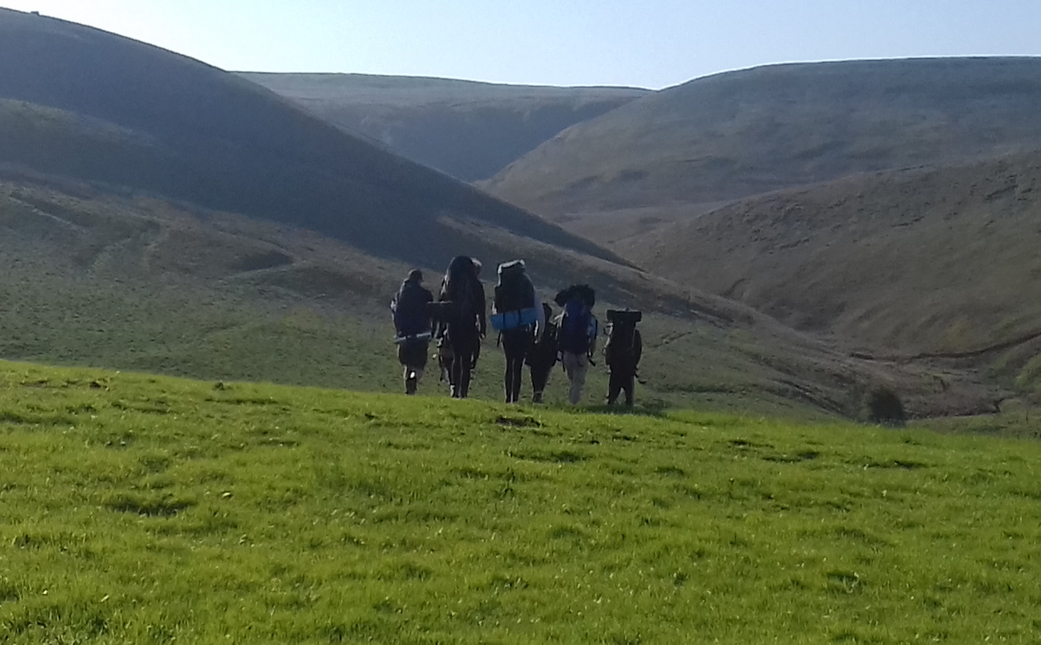
Any Questions?

Slide 17
Contact us
Mobile: 07498 869406
e-mail: stevewilkins@karosadventure.com
Web: www.karosadventure.com

Slide 18
Transport
Normally, with Duke of Edinburgh, parents take and collect students at the drop off and collection points.
This needs to happen 6 times in total and so people try to share the lifts between them.
If you are unable to organise this then we have got a school minibus but there is limited availability on this.
Please could you take some time to discuss this and sign up on the sheet what your plan is with travel arrangements.

Slide 19
Equipment
Many students have already got some of these items.
Some may still need to organise this.
What you take does not have to be brand new or top of the range.
We suggest trying to borrow some items if you are short.
We will be buying some kit in to hire out if anyone is unable to borrow kit.
Could you discuss this and note down on our sheet what your plans are with equipment and if you need to hire what you need to hire.

Slide 20
Behaviour
Students will be expected to follow instructions of the Karos staff and our staff at all times.
All instructions are aimed at keep you healthy and safe and therefore there can be no compromise with these.
If any students do not co-operate with these rules we will call you and ask you to collect them.
Funds for the expedition will not be refunded.

Slide 21
What we need you to do
Pay outstanding payments
Return medical forms and EV4’s
Support your son/daughter with packing and planning food
Organise transport

